Slide 1



Existence and Azimuthal Modulational Stability of Vortices in the Cubic-Quintic Nonlinear Schrodinger Equation
Qualifying Exam
Computational Science
June 1st 2009
Ronald M. Caplan

Slide 2
Overview
Introduction
Steady State Vortex Solutions – Analytic Approximate Profiles
Steady State Vortex Solutions – Numerically-Exact Profiles
Azimuthal Modulational Stability – Analytic Theory
Azimuthal Modulational Stability – Numerical Study
Conclusion

Slide 3
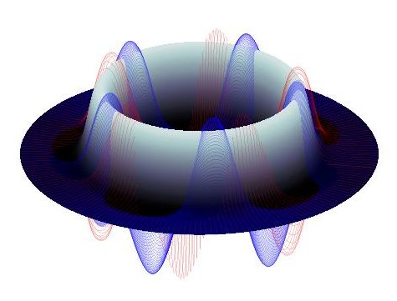
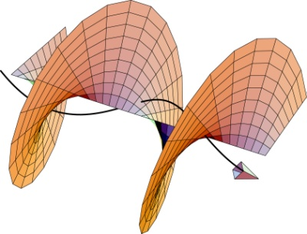
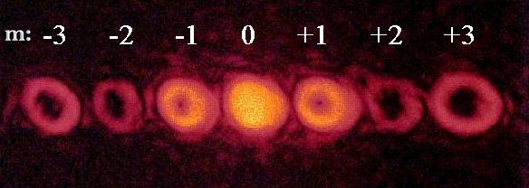
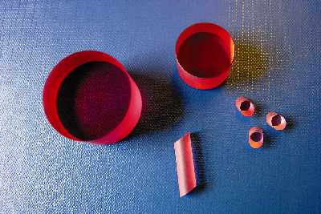
Introduction
Cubic-Quintic Nonlinear Schrodinger Equation and Vortices
Cubic-Quintic Nonlinear Schrodinger Equation (CQNLS)
Vortex solutions: Rotated phase with different topological charges (m)
Applications: Light propagation through nonlinear optical media – Data compression/cryptography

Slide 4
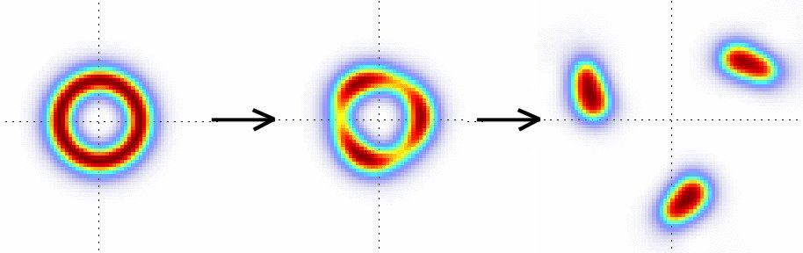
Introduction
Azimuthal Modulational Instability
Azimuthal Modulational Instability (AMI) is exponential growth of azimuthal modular perturbations:
A vortex in the CQNLS can become azimuthally stable depending on the complex frequency and charge

Slide 5
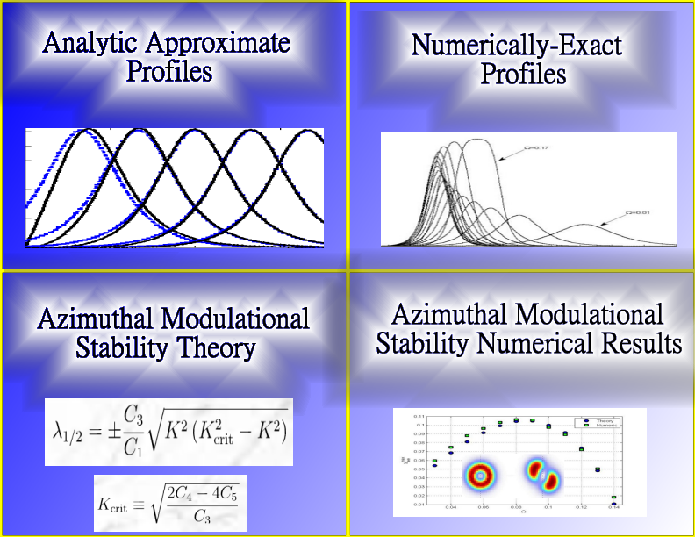
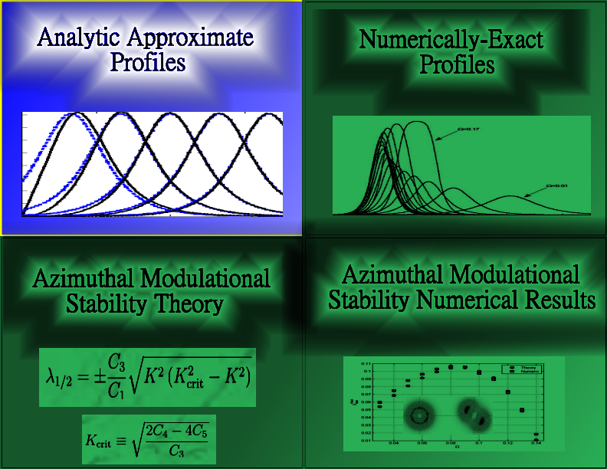

Slide 6
Steady State Vortex Solutions – Analytic Approximate Profiles
Two-Dimensional Cubic-Quintic Nonlinear Schrodinger Equation and Vortex Solutions
Non-dimensionalized
CQNLS:
Polar Laplacian:
General Steady State Vortex Solution:
Two parameters define vortex
Charge
Complex Frequency
Steady State Vortex Profile:
Goal: Find approximate analytical
formulation for f(r)

Slide 7
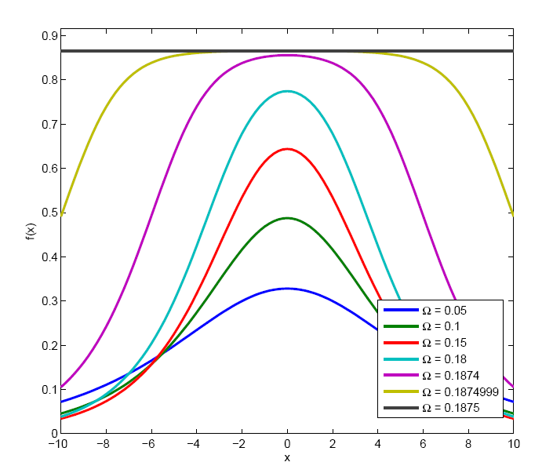
Steady State Vortex Solutions – Analytic Approximate Profiles
Asymptotic Vortex Profile
Inserting vortex solution into CQNLS yields ODE:
Assume:
And define:
New ODE has explicit solution!
Need to find

Slide 8
Steady-State Vortex Solutions – Analytic Approximate Profiles
Variational Approach
Lagrangian density of CQNLS with inserted vortex solution:
Lagrangian:
Radial `C’ constants:
Use asymptotic profile for ansatz:

Slide 9
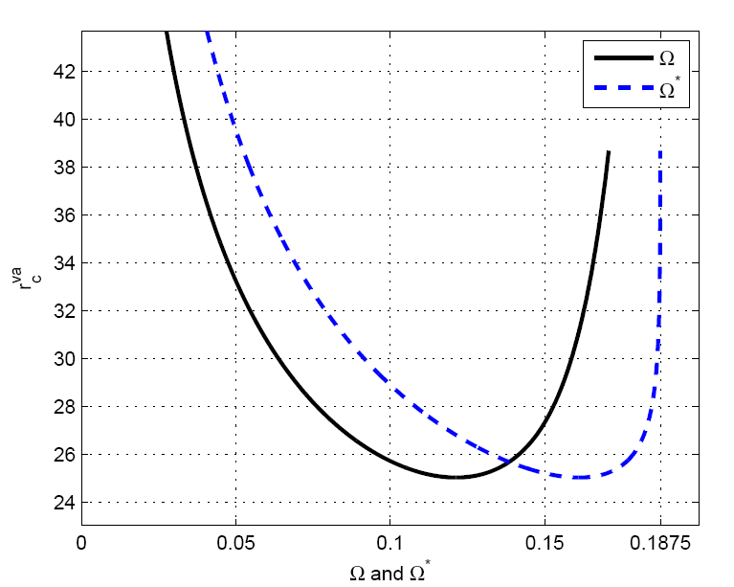
Steady State Vortex Solutions – Analytic Approximate Profiles
Variational Approach Cont.
Solving Euler-Lagrangian Equations:
Yields our VA ansatz:

Slide 10
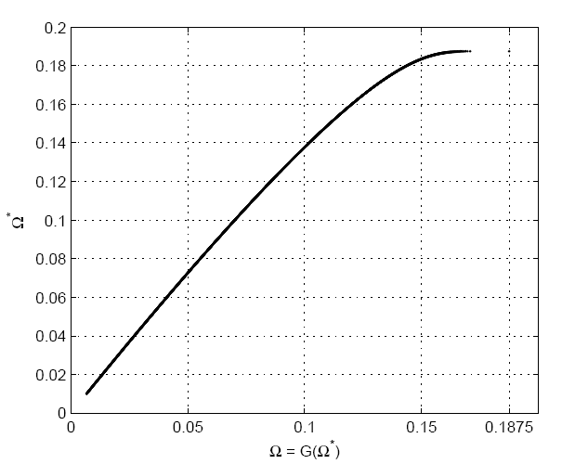
Steady State Vortex Solutions – Analytic Approximate Profiles
Existence Bounds
1D profile has existence bound:
For 2D profile, numerically thought to be:
However, from VA we see that:
Implying that:
(Existence bound proven in subsequent publication.)
Relationship extremely sensitive!

Slide 11
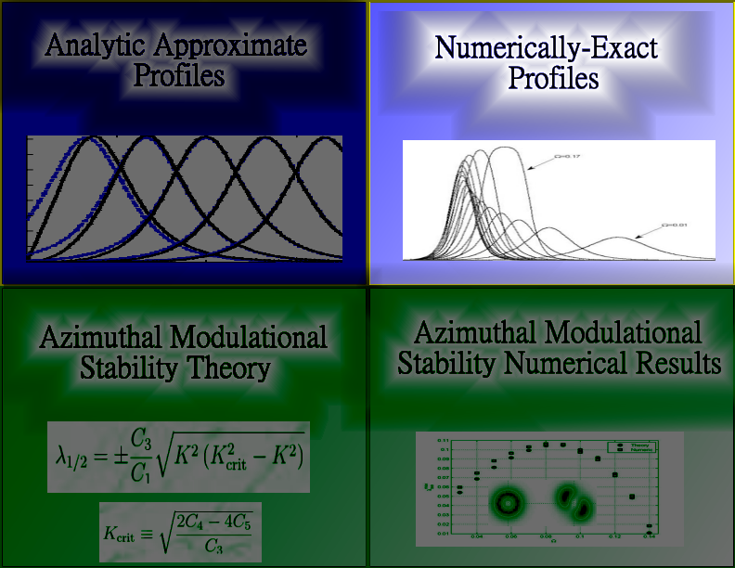

Slide 12
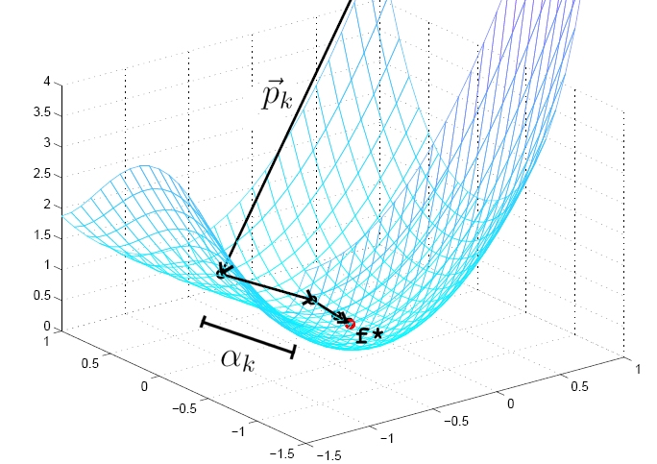
Steady-State Vortex Solutions – Numerically-Exact Profiles
Numerical Nonlinear Optimization
Take profile ODE and discretize:
Iterate initial profile vector:
Progress merit function:
Find step size through inexact linesearch using backtracking with Wolfe condition:
Stopping Criteria:
Step Direction:

Slide 13
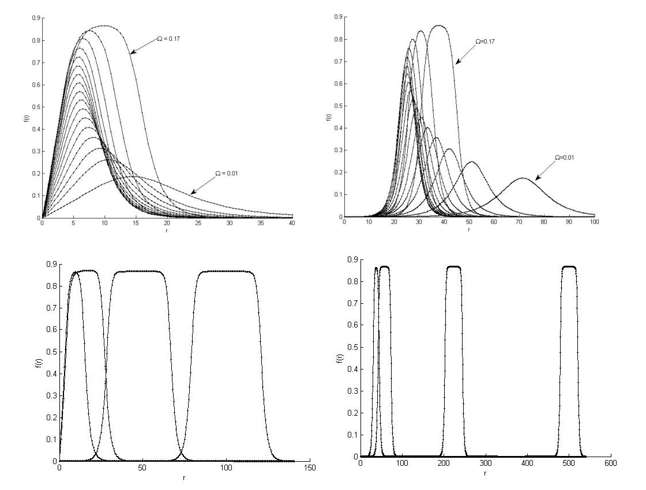
Steady-State Vortex Solutions – Numerically-Exact Profiles
Numerical Profile Results

Slide 14
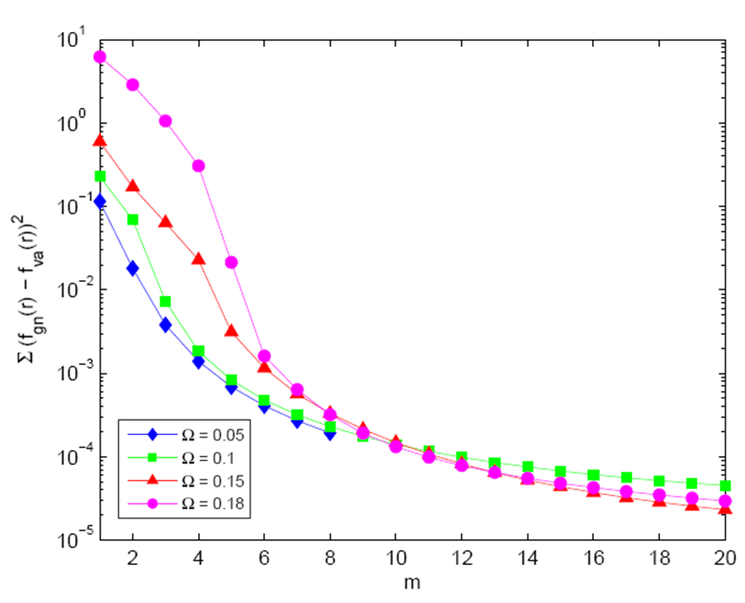
Steady-State Vortex Solutions – Numerically-Exact Profiles
Comparison between numerical and VA profiles

Slide 15
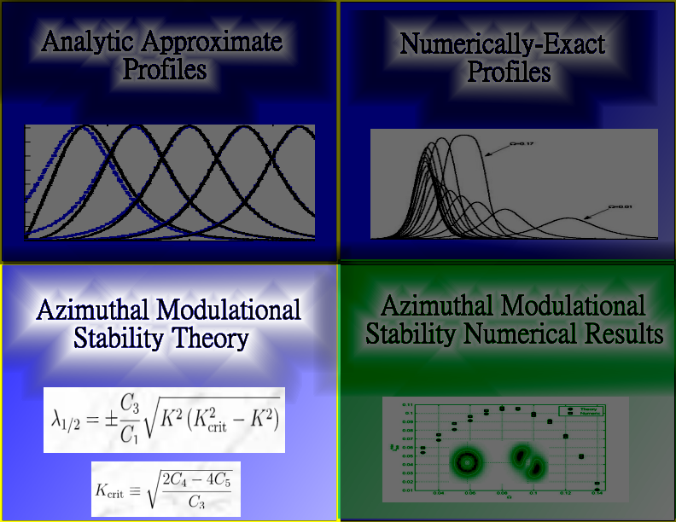

Slide 16
Azimuthal Modulational Stability – Analytic Theory
Azimuthal Equation of Motion
Lagrangian density of CQNLS:
Insert separable solution:
Integrate
Radial
Dimension:
Now have quasi-one-dimensional Lagrangian:
Azimuthal equation of motion is derived using functional derivative:
Azimuthal equation of motion after some rescalings:

Slide 17
Azimuthal Modulational Stability – Analytic Theory
Stability Analysis
Perturb azimuthal part of vortex solution with time-dependant complex perturbation:
Insert into azimuthal equation of motion and separate real and imaginary parts:
Expand in Fourier series to get equation of motion of amplitudes for azimuthal modes
After linearizing, resulting ODE becomes:

Slide 18
Azimuthal Modulational Stability – Analytic Theory
Stability Analysis Cont.
Eigenvalues (with rescalings added back in) give us growth rates of azimuthal modes:
where the critical mode (above which all modes are stable) is:
The mode of maximum growth and its growth rate:
To have an azimuthally stable vortex we need one of the following conditions:

Slide 19
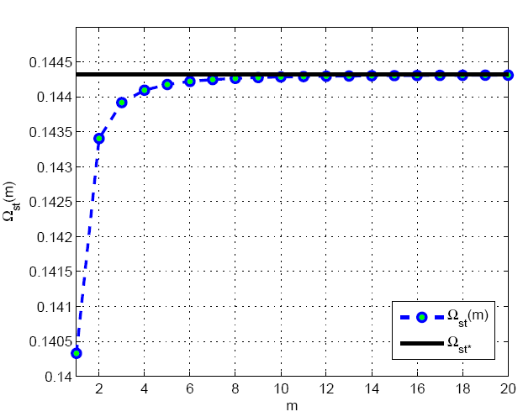
Azimuthal Modulational Stability – Analytic Theory
Stability Predictions from VA Ansatz
We use VA profile to compute C-constants
Using root-solver, can find stability criteria:

Slide 20
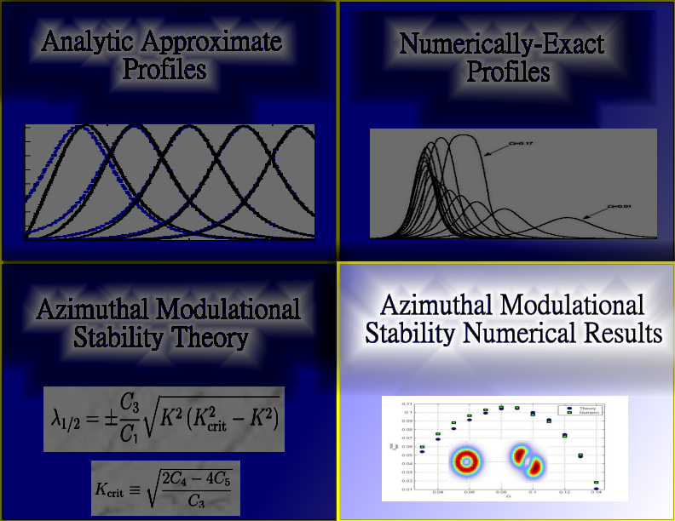

Slide 21
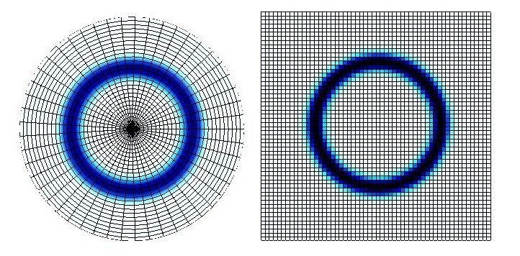
Azimuthal Modulational Stability – Numerical Study
Numerical Method for 2D Simulations
We use both Polar and Cartesian Grids – Advantages/Disadvantages
Time integration: 4th order Runga Kutta
Spatial Laplacian: 2nd order central differencing:

Slide 22
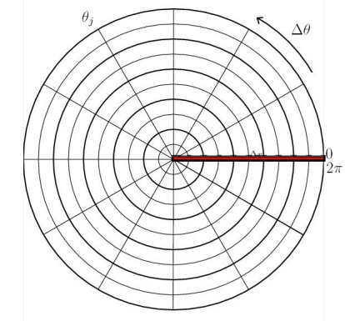
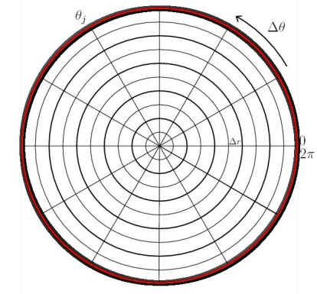
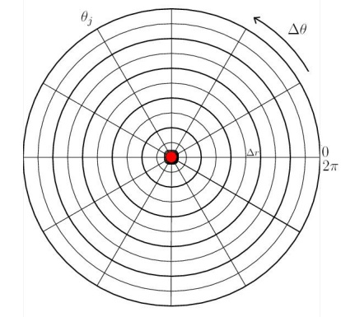

Azimuthal Modulational Stability – Numerical Study
Numerical Method for 2D Simulations – Boundary Conditions

Slide 23
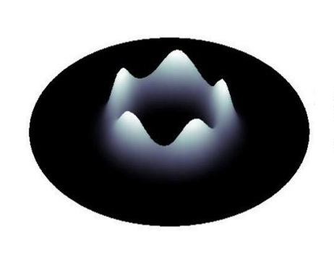
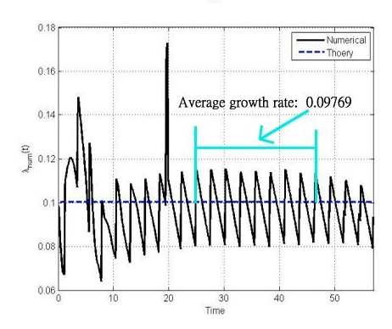
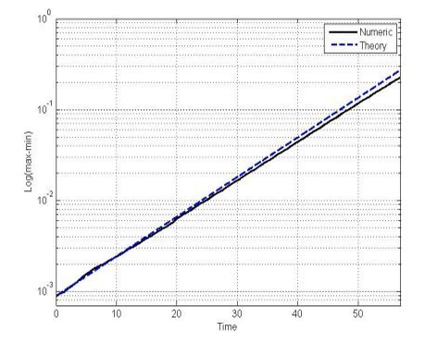
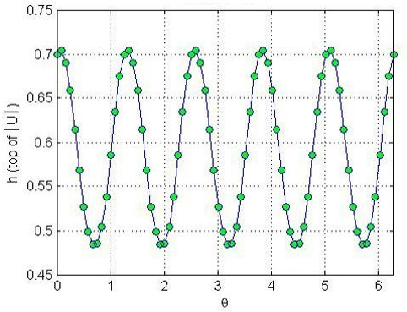
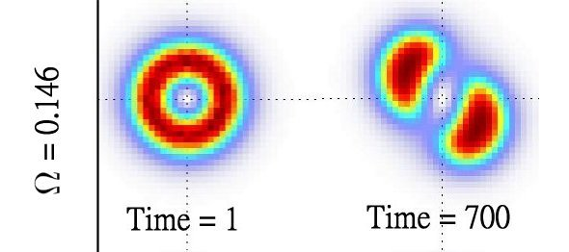
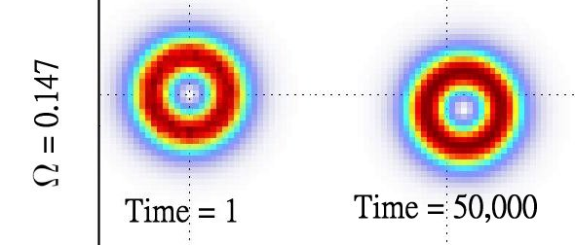
Azimuthal Modulational Stability – Numerical Study
Numerical Method for Computing AMS Results
Unstable Vortices:
Stability of Vortices:

Slide 24
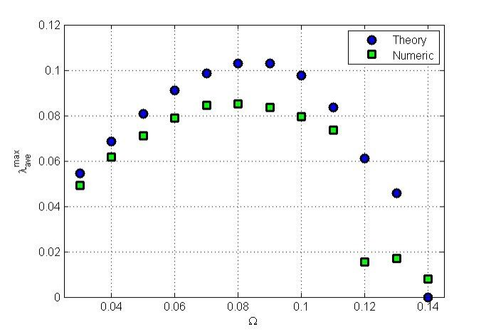
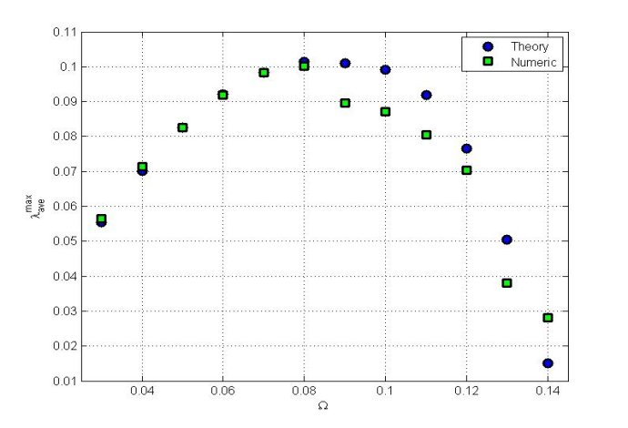
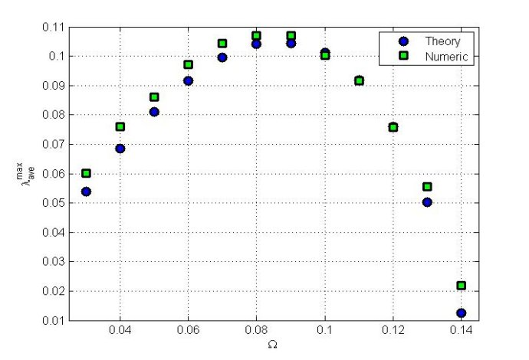
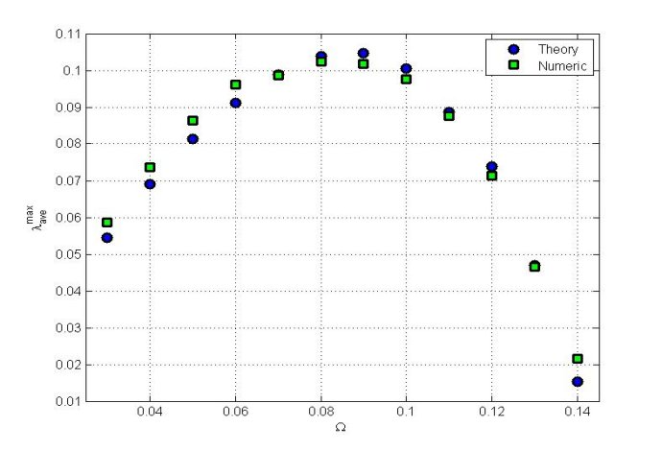
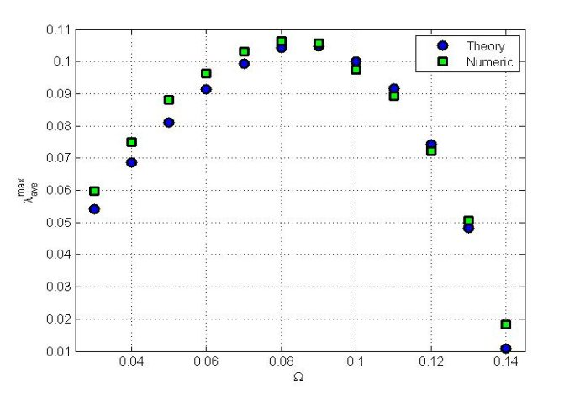
Azimuthal Modulational Stability – Numerical Study
Numerical Results for Unstable Vortices

Slide 25
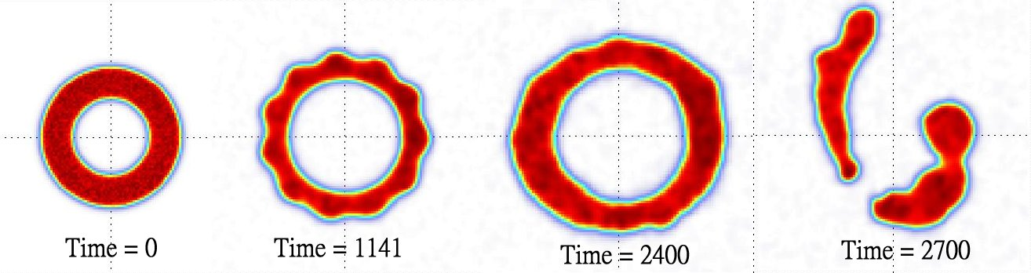
Azimuthal Modulational Stability – Numerical Study
Numerical Results for Stable Vortices
Our Results Compared to Others:
Difficulty in studying vortices m>3:

Slide 26
Conclusion
Extremely close analytic approximation to the vortex profiles using VA
Numerically-exact vortex solutions found using optimization methods.
Predictions of Azimuthal Modulational Stability
Simulations show good agreement for predicting growth rates of unstable azimuthal modes
Simulations confirm past publication’s predictions for critical frequency
Further study

Slide 27
QUESTIONS

