Slide 1
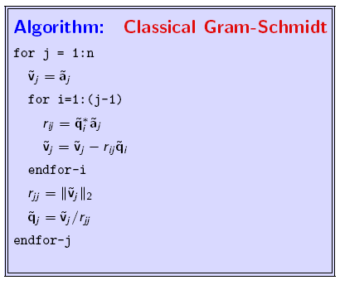
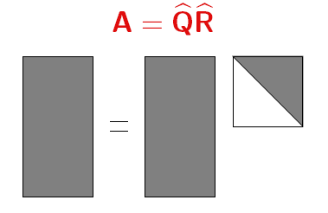
Parallelization of the Classic Gram-Schmidt QR-Factorization
M543 Final Project Ron Caplan May. 6th 2008

Slide 2
Overview
Introduction
MATLAB vs. FORTRAN
Parallelization with MPI
Parallel Computation Results
Conclusion

Slide 3
Introduction
“It is well established that the classical Gram-Schmidt process is one of the unstable ones. Consequently it is rarely used, except sometimes on parallel computers in situations where advantages in communication may outweigh the disadvantage of instability.”
- Trefethem-Bau pg. 66

Slide 4
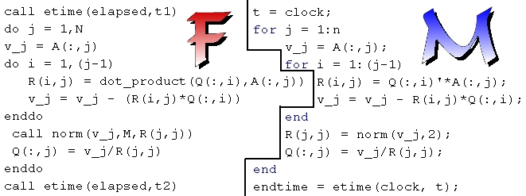
MATLAB vs. FORTRAN
Pentium 4 2.0 Ghz with 512 KB cache, 512MB RDRAM running Windows XP
MATLAB Student Version 7 and g95 with cygwin
Each run is done 5 times and the times averaged.
In-between runs, memory is cleared.

Slide 5
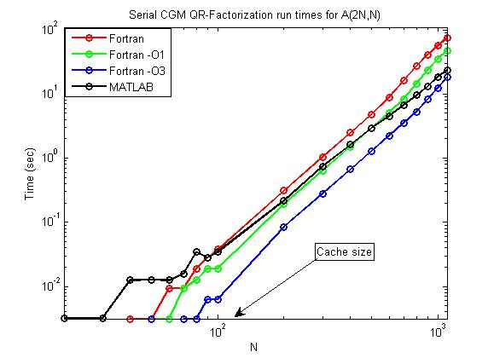
MATLAB vs. FORTRAN

Slide 6
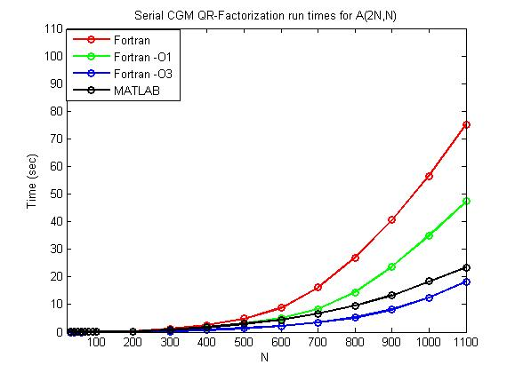
MATLAB vs. FORTRAN

Slide 7
Parallelization with MPI
Collect Q and
R 1 vector
at a time:
Compute
Part of Q & R:
Q
R
Send out A
To all nodes
1 vector at a
time:
A
A
A
A
A 4-node example
Four Dual Quad-core Xeons with 4GB RAM per Node configured as
4 Processors Per Node for MPI/Batch (16 total processors)

Slide 8
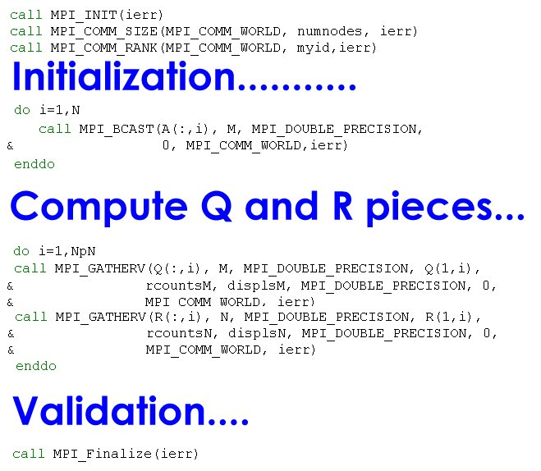
Parallelization with MPI

Slide 9
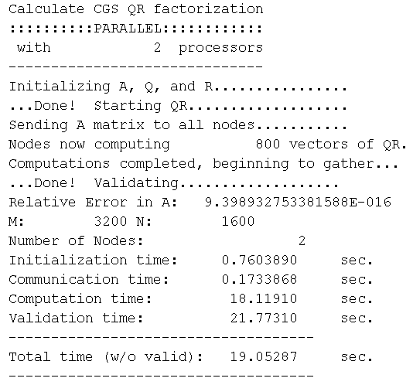
Parallel Computation Results
Using
Frobenius
Norm

Slide 10
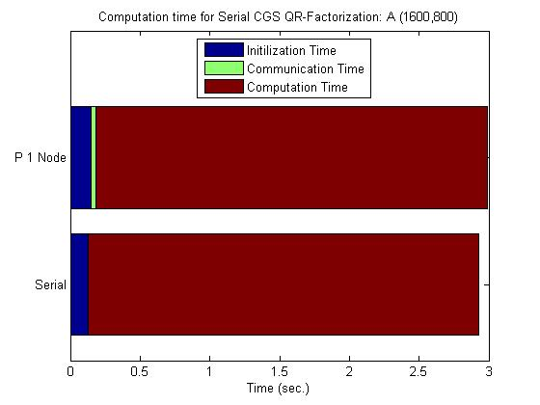
Parallel Computation Results

Slide 11
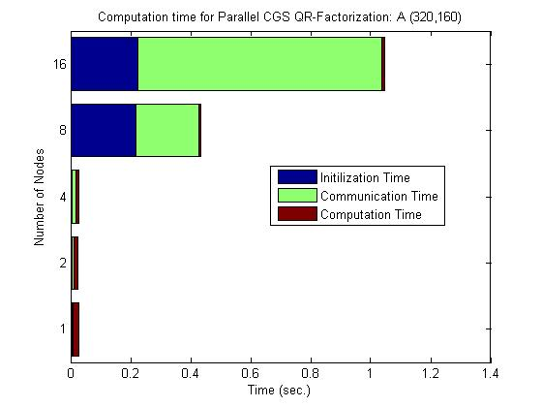

Slide 12
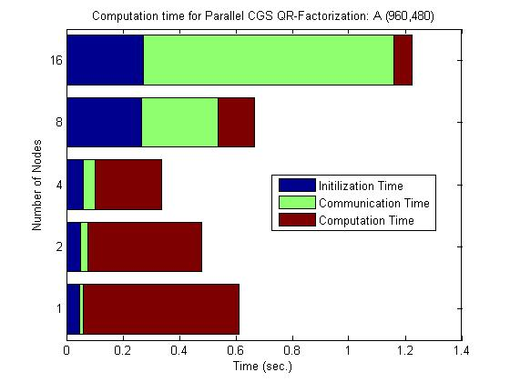
Parallel Computation Results

Slide 13
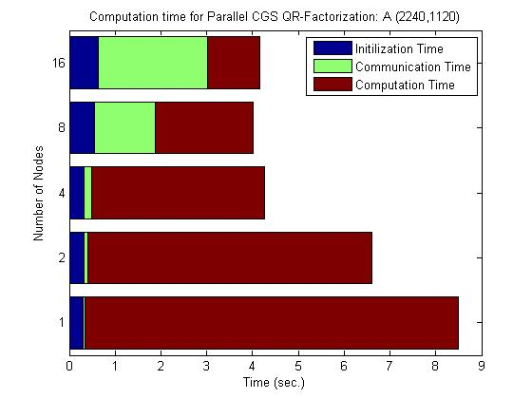
Parallel Computation Results

Slide 14
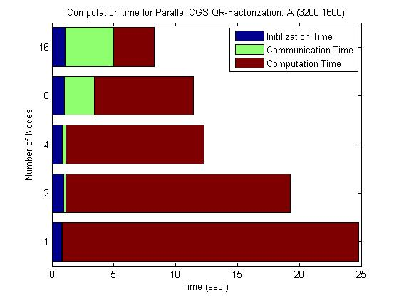
Parallel Computation Results

Slide 15
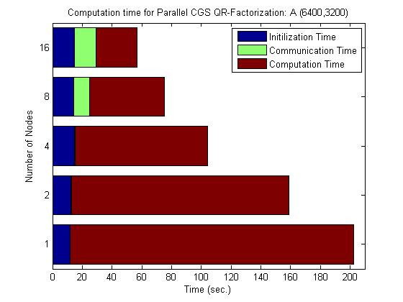
Parallel Computation Results

Slide 16
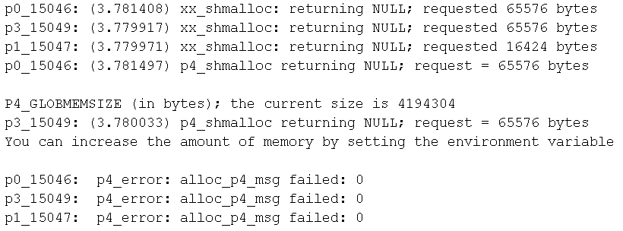
Parallel Computation Results
Should dynamically change send packet size, and probably use sends and receives instead of broadcast and gather…. Why? Because:
Also, since CGS inner loop is from i=1:j-1, the distribution of work to
Each node is not equal. This should be fixed as well.

Slide 17
Conclusion
Parallelization of CGS does give nice speed-up for large matrices.
Adding some improvements to the code such as non-uniform block sizes, and optimizing communication method would lead to even better speed-up.

