Slide 1
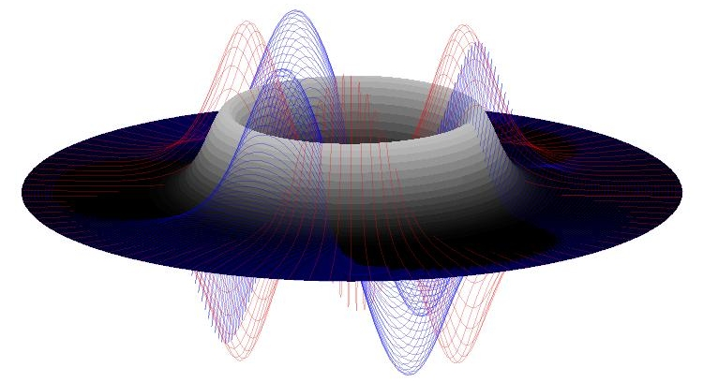
Finding Steady State Vortex Solutions to the 2D Nonlinear Schrodinger Equation Using optimization Algorithms
Ron Caplan
M693A Final Project Dec. 6th 2007

Slide 2
Overview
Background
Formulation of Problem
Methods Used / Results
Classic Newton
Line Search Newton
Gauss-Newton w/ Line Search
Quasi-Newton (Broyden)
Comparison Results
List of Codes Written
Conclusion

Slide 3
Background
The Nonlinear Schrodinger Equation is used when studying such topics as Bose Einstein Condensates and Nonlinear Laser propagation through a crystal lattice.
In either topic, one interesting solution to the two-dimensional NLS is that of vortex rings of different “charges”. These solutions are stationary (not counting the complex phase rotation), but typically unstable.
To study the stability properties of such solutions, (MS next semester), we must find one to start with! However since (as far as we know) there is no analytical solution, finding one of these solutions can be tricky, and requires numerical optimization methods.

Slide 4
Problem Formulation
To set up the problem, we start with the focusing 2D NLS:
The natural coordinate system for this problem is polar, in which case:
To get a steady state vortex, we assume a separable solution of the form:
Where m is the vortex charge. Plugging this into the original equation, we get the following ODE:

Slide 5
Problem Formulation
Discretization
To solve this numerically, we first discretize the problem as follows:
Then, at each r point, we have
and
We can view this discrete ODE as a function of f such that:
Where
and.
This leads us to a set of n coupled algebraic nonlinear equations in which we want to find a vector f which will satisfy the equations.
Obviously f = 0 is a solution, but a boring one. What we want is a soliton-looking profile to use to create the steady state vortex.

Slide 6
Problem Formulation Boundary Conditions
There’s one little issue to deal with and that is boundary conditions. Luckily, in this case it isn’t so bad.
For any vortex solution with charge > 0, the function f, at the point r = 0 is by definition 0.
At r = rmax, it is noted that any vortex solution will decay and go to 0 as r -> ∞. So, if it is assumed that the solution will decay “enough” at rmax, it can be approximated as 0 (guess and check).
Therefore, the numerical optimizer is only run on the r1 -> r(max-1) points, and the boundary conditions are explicitly inserted into the finite difference scheme, and added to the solution afterward.

Slide 7
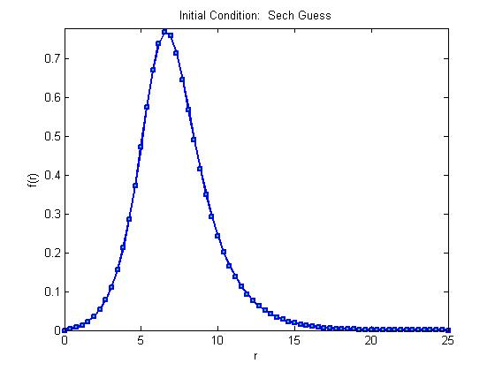
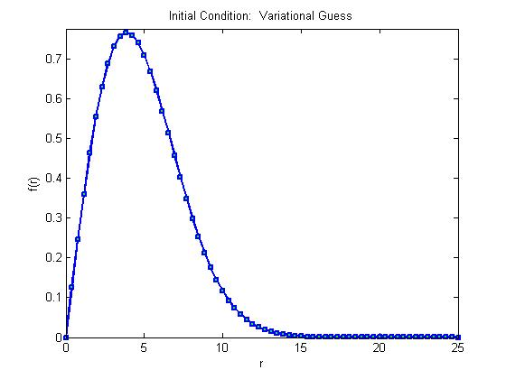
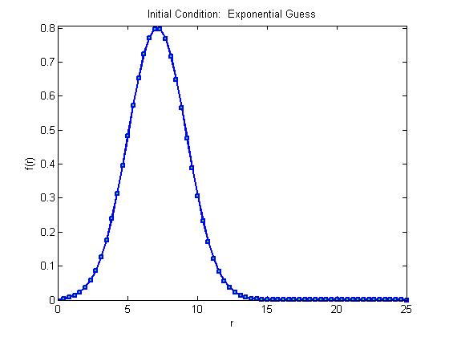
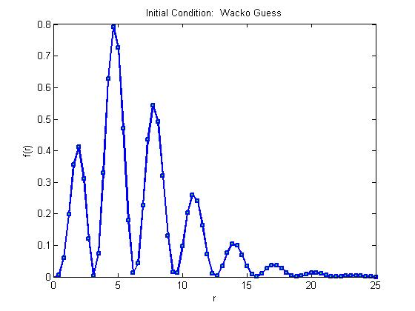
Problem Formulation Initial Conditions
There are different ways to choose the initial guess to input into the numerical optimizers. The following are the four initial conditions to be used in this project:

Slide 8
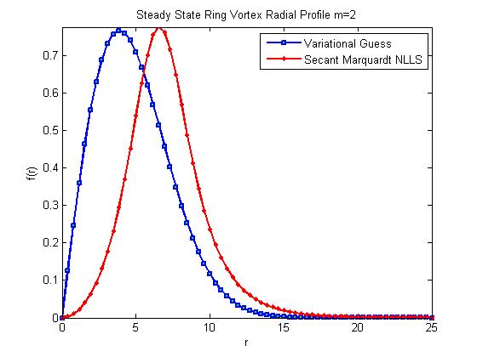
Problem Formulation Solutions
Since we have no explicit solution, how do we know what we get is right?!
A “simple” way is to plug the solution into a full 2D simulation of the NLS and see if it is indeed a steady state solution.
Also, it is a good idea to use someone else’s algorithm, make sure it works, and use
it to compare to the new results.
So, using a code called Smarquart.m written by Hans Bruun Nielsen which is a
nonlinear least squares solver (here, n=m) we get for initial condition #2:
Max f value: 0.77729
Center of Mass: 6.703
Total Mass: 2.1191

Slide 9
Newton’s Method
The NM for Nonlinear Equations is derived from the multidimensional Taylor expansion:
This can be approximated linearly to get:
And thus, the Newton step is:
where,
Close to the solution, this converges superlinearly
Problems!
When initial condition is far from solution, this goes berserk, or may not even be defined (when J is singular)
J might be difficult to compute.
Too expensive for high n.
The root can be degenerate, meaning that J is singular.

Slide 10
Newton’s Method RESULTS

Slide 11
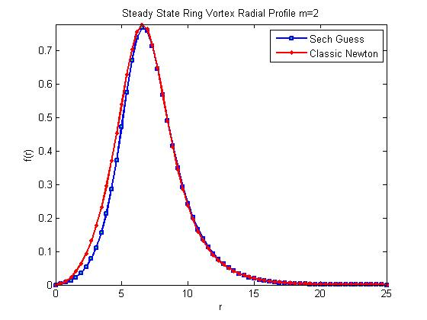
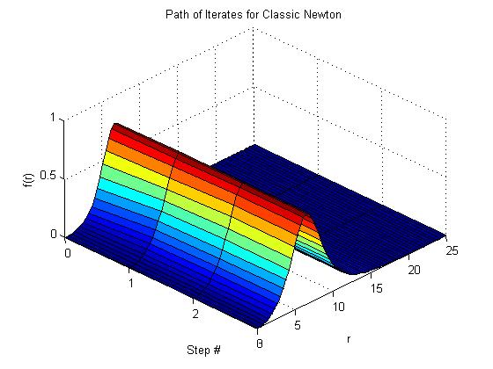
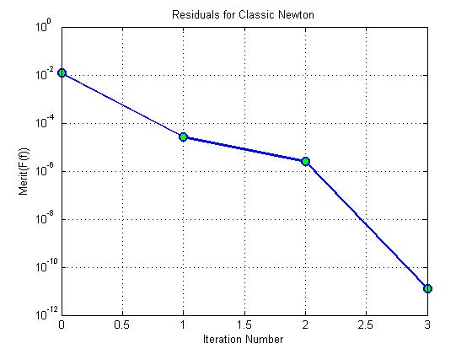
Newton’s Method RESULTS

Slide 12
Newton’s Method
Step# Residual Condition(J)
-----------------------------------------------
0 0.012172379 0
1 2.6278264e-005 581.54652
2 2.457409 e-006 1666.5993
3 1.2784515e-011 1636.3268
Total Steps: 3
-----Final Condition Properties---------
Max: 0.7773 Max f value: 0.77729
CM: 6.703 Center of Mass: 6.703
Mass: 2.1191 Total Mass: 2.1191

Slide 13
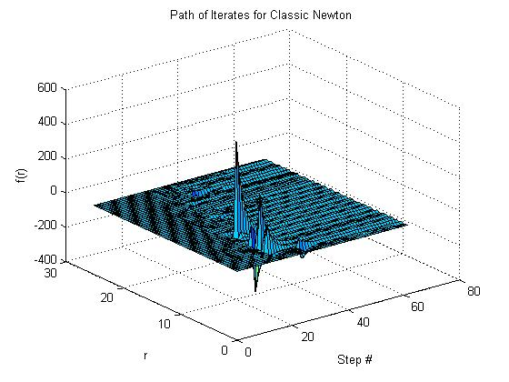
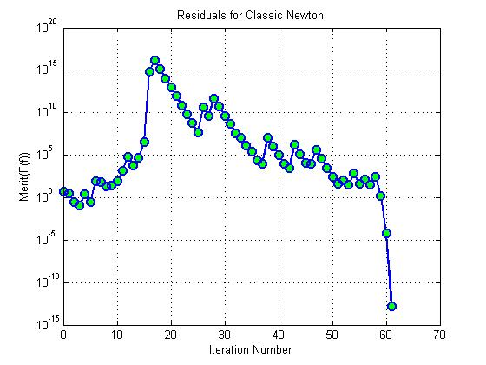
Newton’s Method RESULTS

Slide 14
Step# Residual Condition(J)
---------------------------------------------------------------------
0 5.22619790250016 0
1 2.99172499545966 796.1501495784778
2 0.2978772031907325 188.2274046101671
3 0.121676259118867 193.4295862948274
4 2.581113368198383 234.955148989153
5 0.3256240302981446 182.3123586531078
6 84.01293682711726 667.7519946515165
7 76.50522355485937 187.3381053636464
8 22.19955031088851 302.7663244311606
9 27.84013522402395 226.5112123521828
10 86.46573718095731 195.0873947798124
11 1411.808308371224 215.0414332950961
12 61779.52346466135 511.6302569080676
13 6705.188942579233 1047.538218672788
14 51775.60402688501 1396.323151436513
15 3313983.687640736 2817.750739799736
618100798331540.9 7787.313446432744
17 1.411288385046201e+016 4457700.26268079
18 1238959910170916 8863091.05974092
19 108763913780874.8 1671375.195401667
20 9547296248246.221 1556634.69473601
21 837920496778.1899 28959.22919789867
22 73510330332.7422 334531.5864883275
23 6506780992.225346 18396.05335455933
24 573593369.8541669 5001.569910331665
25 50789278.37608802 1610.096671034785
26 42069447559.12095 11540.01608147828
27 3686711184.172878 43711.19606195566
28 439040446312.4481 23027.62940560422
29 48778169152.64362 20993.5080665105
35 291406.3075538961 192.6504388388663
36 27493.63864415284 124.2370721625107
37 9862.235100683973 50.29278710677804
38 12177374.6912748 53.22572993663506
39 1026467.085604 513.4311253156595
40 111782.8347493885 224.5815476524874
41 10325.5599857793 100.834812370155
42 3162.883366124705 54.74437376431151
43 1646671.78545022 49.16791289350576
44 137778.1399467227 213.7452961350675
45 11095.95266996512 99.71835594738995
46 9913.807529597143 48.26744782191943
47 420468.9290505682 113.9495245279653
48 35234.52389158792 136.8219498495204
49 2969.609081707122 62.17959039021578
50 270.830159802656 36.32306592708839
51 40.49508440220648 36.40764016814018
52 97.73903674086174 36.48488926678456
53 32.24256330643682 36.6148679403298
54 728.7671702392131 36.50450791027413
55 43.94560826650756 36.78442420533874
56 123.392188051348 36.57218244459131
57 29.99919799632708 36.4398127251326
58 253.3005559499469 82.65462634962596
59 1.531648811357331 38.99709364964089
60 6.939712974179337e-005 38.29877216889725
61 1.474160128466838e-013 38.24328903216114
Total Steps: 61
-----Final Condition Properties---------
Max: 5.4699
CM: 12.1929
Mass: 457.1415

Slide 15
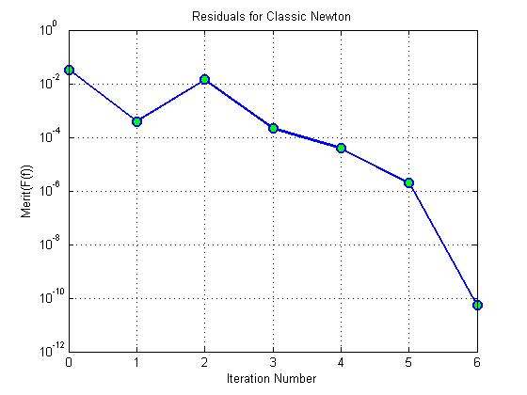
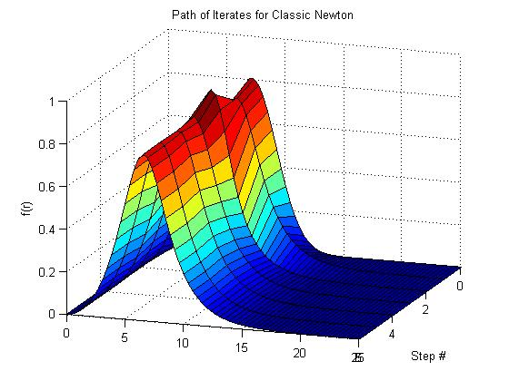
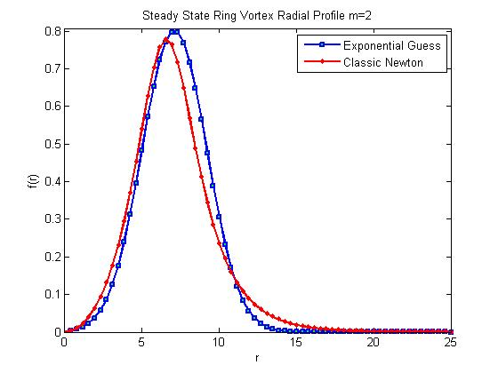
Newton’s Method RESULTS

Slide 16
Step# Residual Condition(J)
-------------------------------------------------------
0 0.033363214 0
1 0.00039380249 421.00531
2 0.013934722 2604.837
3 0.00021192015 3536.1417
4 3.9152128e-005 3040.0266
5 1.9448695e-006 1752.1422
6 5.452798e-011 1633.935
Total Steps: 6
-----Final Condition Properties---------
Max: 0.77729
CM: 6.703
Mass: 2.1191

Slide 17
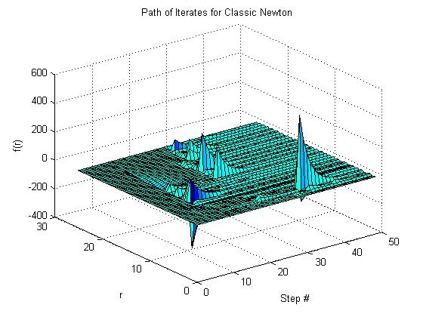
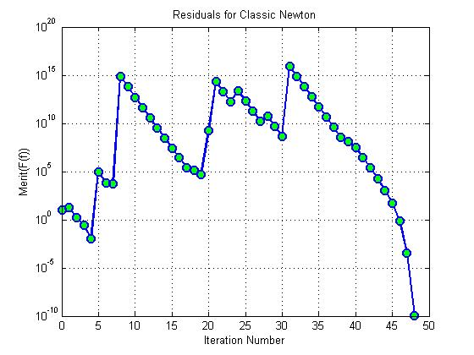
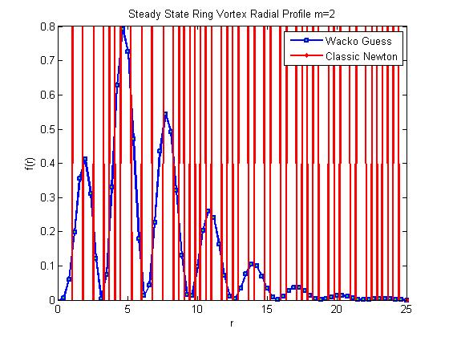
Newton’s Method RESULTS

Slide 18
Step# Residual Condition(J)
-----------------------------------------------
0 10.30707460404252 0
1 17.34222443850154 322.4617916529514
2 1.640234219987699 195.169151468682
3 0.2696143381283133 180.0253533269403
4 0.01098245734001832 188.6408360868868
5 82520.76029589561 10927.978771189
6 7098.633233619883 553.0464298505307
7 4883.615649692215 344.1097172366659
8 679096437852416.1 4632.3553577662
9 59614941996073.47 1251158.966908546
10 5232903784983.995 1004186.210358385
11 459249688151.5653 744052.9924559721
12 40287491851.6099 508576.9656697817
13 3530780303.975353 217231.7539732317
14 308748108.9652588 30685.61610054946
15 26860590.93670855 8502.171967897541
16 2608979.427850497 2931.996886118424
17 251266.9865753435 2149.886288383796
18 132651.2940547916 1087.066352332989
19 52776.55887438428 903.5398901664562
20 1651432046.598745 3550.562102016589
21 211016944158740.8 84230.01836603716
22 18523359276481.83 295696.9206357325
23 1682677424858.547 834117.7921162557
24 24816358498782.04 171169.8572390945
25 2178022091227.427 13367.33526054685
26 191081638218.5437 20053.15531574508
27 16748999594.26263 6611.766396743587
28 56924462389.04227 7004.300933939296
29 4988790806.641295 2077.128136143326
30 436296561.2564363 928.6002518156682
31 8672200707115672 61005.82331556927
32 761328104709418.4 372067.7195668114
33 66834621505107.15 235451.6293220857
34 5866821364251.351 101514.5089147092
35 514917896516.93 14799.2711571328
36 45177363845.17554 6240.639200176302
37 3960432751.031525 2719.071845794482
38 346479332.0320864 1203.543294214672
39 123248007.194282 1566.669409633951
40 32896923.98614352 1143.203903844249
41 2798647.500947324 218.664072240335
42 229376.1944644627 98.8175368025926
43 17703.25893591974 45.67334449282859
44 1164.890577389915 22.30529930512641
45 50.47055329639153 16.11630985816319
46 0.6878909643877654 16.11655681131908
47 0.0003619298354966505 16.11658797012264
48 1.185639883910691e-010 16.11658635379151
Total Steps: 48
-----Final Condition Properties---------
Max: 5.2239
CM: 13.3254
Mass: 492.8574

Slide 19
Linesearch w/ Merit Function
It was expected that Newton would fail if the initial condition was far from the solution and it did. How can this be fixed?
Well, how about adding a linesearch to the method?
But the linesearch needs a scalar function and gradient to work and in this case, both are vectors!
The solution is to use Merit Functions.
The standard merit function to use is a sum of squares:
In which case, the gradient is exactly:
There is something to take note of here. With this merit function, we can get stuck in a “minima” of the merit function which does not correspond to a root of F! This will happen when J becomes singular (i.e. its condition number goes to infinity). Thus, the Linesearch-Newton step can get attracted to non-solutions!

Slide 20
Linesearch-Newton
RESULTS

Slide 21
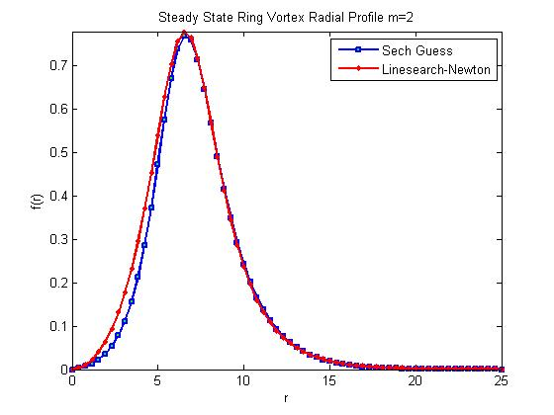
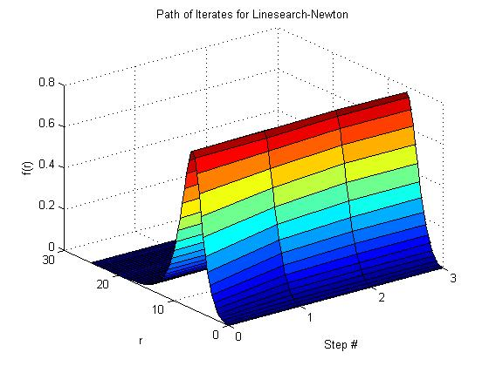
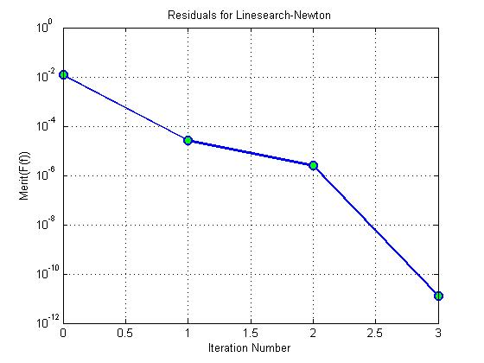
Newton’s Method RESULTS

Slide 22
Step# Residual Condition(J) LineS Step#
-----------------------------------------------
0 0.012172379 0 0
1 2.6278264e-005 581.54652 0
2 2.457409e-006 1666.5993 0
3 1.2784515e-011 1636.3268 0
Total Steps: 3
-----Final Condition Properties---------
Max: 0.7773
CM: 6.703
Mass: 2.1191

Slide 23
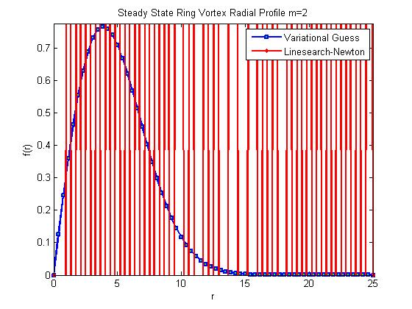
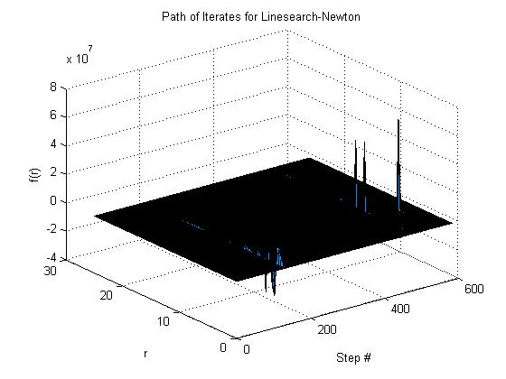
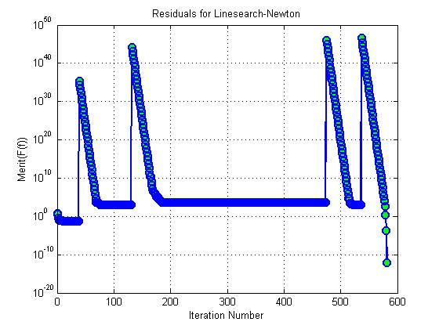
Newton’s Method RESULTS

Slide 24
Step# Residual Condition(J) LineS Step#
-----------------------------------------------
0 5.22619790250016 0 0
1 2.99172499545966 796.1501495784778 0
2 0.2978772031907325 188.2274046101671 0
3 0.121676259118867 193.4295862948274 0
4 0.1005959422940175 234.955148989153 2
5 0.08687872157450557 267.4620841571193 2
6 0.07974408773822915 321.8440660508367 2
7 0.07491429050555119 428.6113179685262 3
8 0.07106872164845381 497.9722580425154 3
9 0.06862693746478102 612.1102540886681 3
10 0.06711106953269443 847.611825844868 4
11 0.065996248861456 1034.459947609872 4
12 0.06581495261181448 1411.76161855796 4
13 0.06562826125829732 2803.091990897801 6
14 0.06554135900581039 3736.501386657929 6
15 0.06552128867571345 6729.8057402667 7
16 0.0655129632230856 14204.69222218501 9
17 0.06550925233130567 20718.99397651843 10
18 0.06550721714869769 27467.46339901692 10
19 0.0655066596367877 48361.52593889406 11
20 0.06550647886689419 95257.28850608041 13
21 0.06550639215199962 128415.6653110048 13
22 0.06550638369436701 241986.8737725746 14
23 0.06550638122591251 625292.7838271492 16
24 0.06550638035941669 1401382.322955673 18
25 0.06550638001821033 2247324.695204415 19
26 0.06550637987639803 3490266.986615733 20
27 0.06550637981414602 5102687.524891628 21
28 0.0655063797804704 6789674.05596276 21
29 0.06550637977225322 12122479.74547861 22
30 0.06550637976952121 25040524.23194617 24
31 0.06550637976906613 35664902.63737655 24
32 0.06550637976892211 90134894.88678479 26
33 0.06550637976887372 188708949.7157354 28
34 0.06550637976887171 273439532.7386097 28
35 0.06550637976886901 782636725.9953386 31
36 0.06550637976886782 1065229581.033463 31
37 0.0655063797688674 2095644194.106355 33
38 0.06550637976886721 2821640165.693458 33
39 2.41852753294327e+035 5296597944.269397 37
40 2.123267093355255e+034 2350681510.08705 0
41 1.864048304472526e+033 2415050359.328377 0
42 1.636481843048948e+032 2574697045.34308 0
43 1.436694815887062e+031 3032100613.421751 0
44 1.261299061389705e+030 5159021805.577951 0
45 1.107316085277e+029 7555153386.12928 0
46 9.721284060233651e+027 1357444564.947803 0
47 8.534453075844886e+026 1700912821.72808 0
48 7.492528051096386e+025 1654987614.29678 0
49 6.577805718528009e+024 508862986.5275876 0
50 5.774752203113712e+023 750618370.5059575 0
51 5.069742038459127e+022 144662675.3573148 0
52 4.450802742872199e+021 114946721.7319112 0
53 3.907425705065841e+020 71341866.8656794 0
54 3.430386702182356e+019 35407870.14173843 0
55 3.011586430368145e+018 15971150.13743023 0
56 2.643914317913149e+017 8163950.669641024 0
57 2.321127098358782e+016 7313731.515172502 0
58 2037742596931657 15640284.92900898 0
59 178894575641067 4018644.952920731 0
60 15705048694127.09 871854.714123138 0
61 1378695930828.287 295113.1063710848 0
62 121023216028.1864 115784.7060231293 0
63 10621938642.14883 48640.67899451577 0
64 931951572.1133772 21162.27276742202 0
65 81707282.43633595 9376.541098381995 0
66 7152197.618795228 4188.447391680831 0
67 624344.2639388514 1871.520352220159 0
68 54960.64332101621 829.9528306055205 0
69 5181.732932527627 362.4949451300412 0
70 4868.081510597262 187.5859667001323 1
71 4174.194751329364 271.6158498123066 2
72 4162.12504235681 268.9255167016276 5
73 3383.508432344283 281.5786917387902 2
74 2196.95579263281 350.7216965104647 1
75 1357.36145433394 176.0760126848518 1
76 1269.245631524232 243.8892671055153 3
77 1203.042639480916 363.1392987383143 3
78 1178.391652038553 1518.976272794253 4
79 1177.053227841215 631.484019265671 7
80 1176.436768735896 639.8469719065046 7
81 1172.868071278896 656.3546314060421 6
82 1171.003361760924 687.1096669942967 6
83 1162.372057706452 743.6844015181367 5
84 1154.130894275639 884.1905248808765 5
85 1146.034075790912 1237.395338822583 5
86 1136.693847467888 1766.11418894458 5
87 1134.253081566314 20046.55779824767 5
88 1111.303060357539 880.8188065988771 4
89 1107.251277275431 1495.960160624602 5
90 1089.580886566617 1335.735447537503 4
91 1070.078292052152 1689.170321038267 4
92 1054.483459294536 849.3213647065446 4
93 1050.15475484172 620.2858635569784 4
94 1046.233642692743 724.7130052308313 5
95 1037.468686358078 614.4657359364758 5
96 1037.312171131478 738.7152701760838 9
97 1037.307107477934 3787.314872094262 12
98 1037.305862051097 4602.631120600242 12
99 1037.299711334769 2698.51734592954 11
100 1037.278265486574 1830.133038647631 11
101 1037.277956446841 12008.35931760671 14
102 1037.276890666239 8172.662279538649 14
103 1037.276876994375 54409.45461179955 17
104 1037.276872579542 35623.487042559 16
105 1037.276683838642 18309.09335812505 15
106 1037.276411061181 16466.65071977822 15
107 1037.276273592429 23088.69748156843 16
108 1037.276266293175 98344.40699742368 19
109 1037.276266184619 834185.3222695073 23
110 1037.27626616956 1765590.345412412 24
111 1037.276266122316 1237477.678384102 24
112 1037.276266120505 6442504.063284916 27
113 1037.276266119833 10583924.32734573 28
114 1037.276266119595 17722948.66121294 29
115 1037.276266119494 27371479.40220178 30
116 1037.276266119487 61429205.9124519 31
117 1037.276266119459 36592798.33435185 30
118 1037.276266119423 23104014.1449203 29
119 1037.27626611911 12836234.47083689 28
120 1037.276266118292 9513192.359135455 28
121 1037.276266118232 32759749.23772303 30
122 1037.276266118153 30592885.19148698 30
123 1037.276266118139 37961180.43306238 30
124 1037.276266118031 21318565.58251161 29
125 1037.276266117721 15404500.72941219 29
126 1037.276266117717 62946717.40197368 31
127 1037.276266117673 34725434.12617465 30
128 1037.276266117564 26171606.34624383 30
129 1037.276266117553 81334062.86014412 32
130 1037.276266117547 111756757.6021886 33
131 1037.276266117547 558491931.7570006 36
132 1.746013678388907e+044 1132541107.94158 37
133 1.531586015786847e+043 5925241.148070134 0
134 1.344632776851145e+042 5925241.106041865 0
135 1.180458882689266e+041 5925195.740125396 0
136 1.036324814096e+040 5925094.766069761 0
137 9.098014798716424e+038 5925041.418855016 0
138 7.987406473819562e+037 5925067.463127977 0
139 7.012330314377019e+036 5925130.603231482 0
140 6.156182004643566e+035 5925154.372364072 0
141 5.404587345730327e+034 5925254.195466313 0
142 4.744789664623569e+033 5925508.094635041 0
143 4.165535095165672e+032 5926069.380142162 0
144 3.65700723686924e+031 5927353.374503469 0
145 3.2105510393246e+030 5930220.144084572 0
146 2.818594852873719e+029 5936666.233150506 0
147 2.474490817868448e+028 5951221.866540576 0
148 2.172389541672948e+027 5984240.411500079 0
149 1.907171421395808e+026 6060003.046924749 0
150 1.674335153984668e+025 6238248.774268745 0
151 1.469923500202498e+024 6683587.20867717 0
152 1.29046750314744e+023 7985849.955056032 0
153 1.132920737066722e+022 14601763.83370654 0
154 9.946077821953915e+020 14677007.54014151 0
155 8.731802044917249e+019 3873221.436622999 0
156 7.665763798094164e+018 3360694.724249674 0
157 6.729857868395474e+017 2739039.045882446 0
158 5.908182367735074e+016 972261.5098905057 0
159 5186761954779725 13373837.94205971 0
160 455329926332748.9 533687.7866497408 0
161 39969418569321.56 213220.8500676313 0
162 3508050000746.49 121135.1538202893 0
163 307793675636.4505 73718.48550876585 0
164 26985226819.04943 67310.91994101806 0
165 20491250842.87692 332811.0274779255 2
166 1792904750.926274 33186.02708131427 0
167 156147121.5539814 19332.82077929368 0
168 13456291.70742765 4883.897120222478 0
169 3726273.906138486 1265.358971545568 0
170 3543520.316348058 2233.112128040183 0
171 1655557.535346397 886.8006059012332 1
172 1313120.686399185 1293.121371403155 1
173 607442.9953078327 342.3826231198019 1
174 415021.194603529 329.0743685750902 1
175 137208.6643275125 107.5798663947838 0
176 108134.4731701288 577.9734385945774 2
177 98872.3011853387 306.4782293143903 3
178 65015.02580139896 131.1664705396764 1
179 33472.44561070238 104.4538878903708 1
180 24380.96315657565 82.79909401616561 1
181 23698.54813925535 154.2455172017669 4
182 11756.49593606208 53.63518572382674 1
183 10025.52453574291 54.92691993270651 2
184 5848.935255608521 82.19638627517099 1
185 5503.651683726702 35.24712196545854 3
186 5492.4544772816 168.4972429571291 6
187 5376.19276957174 51.05116238888311 4
188 5192.511765614889 58.55960091715188 3
189 5155.049777421339 184.1364543852297 5
190 5149.500193064829 2017.678970927498 5
191 5109.13490129699 95.79430570363266 5
192 5066.82411533083 477.5140696628469 5
193 5050.397596190409 227.2906368480408 3
194 4974.697504946408 84.95334690912227 4
195 4971.827449234008 106.6189829661271 4
196 4969.892911791129 395.6508046845494 7
197 4883.066235760445 242.0398137509258 4
198 4848.02337971842 190.47147937012 5
199 4806.960468239468 300.8345804976617 4
200 4794.873796058567 141.3023449661185 5
201 4747.883013699204 146.1725638894717 4
202 4600.574954879738 1279.214574730761 3
203 4591.277988900322 176.2934661248024 6
204 4590.560444986137 625.9892134572403 8
205 4580.141393385732 171.7669620214612 6
206 4580.087435710433 2631.400372661496 11
207 4578.15565810071 362.8788842315312 7
208 4577.452787271294 1363.880822430667 9
209 4576.912698576699 225.0102585083572 5
210 4576.572308359605 927.7099432933326 9
211 4576.25955281292 1042.492014814181 9
212 4569.406467685492 168.1240419916328 6
213 4560.84537351668 150.7864338469921 6
214 4559.625478620769 552.1119995569143 8
215 4550.203435961677 87.99931365070123 5
216 4537.338838714156 155.2380397827195 6
217 4536.596343029365 411.0808007304059 7
218 4534.985073421266 55.60981963711969 4
219 4455.976159493494 72.78748373645827 4
220 4425.269983100858 69.68867491310775 4
221 4414.601921096878 525.5125722350878 5
222 4414.520009328905 1497.577282366389 11
223 4414.286291030299 912.837636341079 10
224 4413.732921696091 600.5815849656123 9
225 4413.54938914857 337.6353920858264 7
226 4385.325128404445 74.30194352889657 5
227 4374.528250590578 134.7803921891545 6
228 4369.826529013077 178.5076280799264 6
229 4365.574381983692 198.3495989159005 7
230 4360.822898135762 180.7919439956925 7
231 4360.770389978029 1762.224366856079 10
232 4360.541857120395 1162.350906946811 10
233 4358.783892520337 320.1827968882396 8
234 4358.622023769386 1186.285770484923 10
235 4358.519156313439 551.030197927377 8
236 4357.86312631508 654.2324445868422 9
237 4356.986494531124 306.1504981693179 7
238 4356.808154086325 2745.460406269458 10
239 4353.393219942991 327.4008707642128 7
240 4352.251381624539 330.15111435452 7
241 4352.233682274874 8384.46504066196 12
242 4350.902486553812 743.2465009573551 8
243 4349.649806368123 355.0150225538757 8
244 4348.649327381798 457.2378328801399 8
245 4347.979358030829 592.1648905193349 9
246 4347.932876953312 3742.969506317273 11
247 4347.389414189292 689.1418732836796 9
248 4347.372209459983 4205.752827426069 12
249 4347.134792565134 1530.48337200061 9
250 4346.767609423463 553.9985779102011 8
251 4346.766559266635 18620.45464613864 15
252 4346.738704103441 2876.678349477054 11
253 4345.811298218966 432.5946758924536 8
254 4344.058181264851 673.6846836354351 8
255 4344.031671547873 2914.969018261727 11
256 4342.295801374056 324.9735052198794 8
257 4342.122078709591 1331.400624243951 10
258 4341.526497204648 547.522858698199 9
259 4341.370339854429 1149.677358188034 10
260 4341.358873066482 5503.505032174969 13
261 4341.278501560522 2359.614324339215 11
262 4341.254398001849 2367.037328574738 11
263 4341.254289601036 43032.73054827828 15
264 4341.253274312515 16088.59024313329 15
265 4341.244391472268 8758.731420033788 13
266 4341.232767109174 8677.740780402966 13
267 4341.232462925132 32472.48563035913 16
268 4341.222724044375 4411.414280387928 13
269 4341.221596458219 12393.95971739816 15
270 4341.217612026855 5062.906432895279 13
271 4341.217607549553 33590.19240485397 15
272 4341.20780752771 3947.49536708754 12
273 4341.203940254597 3492.27464666565 12
274 4341.203848378496 108687.2180350922 17
275 4341.197502711721 8728.745916961723 13
276 4341.1617272181 2350.024238471222 11
277 4341.073999466738 1538.144217365889 11
278 4341.071440783104 15273.17852781538 14
279 4341.070211703429 13004.99727634565 15
280 4341.068958033457 11687.39353475055 15
281 4341.06765375507 10256.4349356778 14
282 4341.066029240209 8617.120900635489 15
283 4341.065816460559 26101.85877867622 17
284 4341.065678610776 53062.36612786224 17
285 4341.06558446804 32466.70055164005 17
286 4341.065424948632 71754.37847780887 17
287 4341.065354015244 40977.16819282157 18
288 4341.065302096019 48052.29094126094 18
289 4341.065227833721 33080.71598090918 17
290 4341.064854677314 29587.95598791173 16
291 4341.064646354461 21575.96273991429 16
292 4341.064624765378 230043.9133306637 19
293 4341.06461677171 208983.0126785809 20
294 4341.064419383479 37016.99914675665 17
295 4341.064330944886 103651.0942341993 17
296 4341.063874425607 19746.72638385977 16
297 4341.06365731668 26987.38319126521 17
298 4341.063483715723 22460.48191360264 16
299 4341.063454393323 103806.9505885287 19
300 4341.063423425883 102612.2836780462 17
301 4341.063124947503 17102.19215021009 15
302 4341.062585203986 35316.25859480323 16
303 4341.062554072048 42185.94320933026 17
304 4341.061299109319 14939.59347279189 15
305 4341.060898785333 17012.79994826824 15
306 4341.060237905881 11897.97280198943 15
307 4341.060036554079 61763.50225084587 16
308 4341.060010407674 115470.3356631087 19
309 4341.059623077334 25575.01357762217 16
310 4341.059396232036 26347.51065953211 17
311 4341.059386052769 129837.1884097356 20
312 4341.059363285449 86001.67472604578 19
313 4341.059297349932 43147.59340565304 18
314 4341.059233994765 48038.20336993869 18
315 4341.059169945728 47475.08070573715 18
316 4341.059164683925 240209.7103933461 20
317 4341.059162443859 37924.66550269983 17
318 4341.058586651283 15575.37993976922 16
319 4341.058580676564 159717.1528991324 20
320 4341.05857497597 59105.45315433988 18
321 4341.058401739205 26309.52434642416 17
322 4341.05837308881 82211.19251516527 19
323 4341.058372863526 772680.2345275136 23
324 4341.058369472246 225588.2369583743 21
325 4341.058359663098 126236.2725487562 20
326 4341.058356830805 92295.03270442506 19
327 4341.058355334279 485095.0562767861 22
328 4341.058342004442 133772.1179771466 19
329 4341.05833074014 102085.3951752988 20
330 4341.058330246488 362136.3531328086 21
331 4341.058326473022 210609.3905288031 21
332 4341.058319560698 147376.6763086913 20
333 4341.058315506944 271490.9766876779 21
334 4341.058305642878 86847.77942642506 19
335 4341.05826063313 43608.94470623751 18
336 4341.058220536415 46182.27177211636 18
337 4341.058170691338 47451.92906789656 18
338 4341.058166081502 145618.79364514 19
339 4341.058165348614 307409.6610050789 21
340 4341.058144024281 74493.97473004249 19
341 4341.058115032335 62532.60506618457 19
342 4341.0581059967 114932.5351927767 20
343 4341.058098151297 125077.7998216564 20
344 4341.058087501127 104040.5820501304 20
345 4341.058084447775 243740.1291135871 21
346 4341.058083456496 290692.1529761147 21
347 4341.058080736735 340862.0162011585 21
348 4341.058072959247 123640.9335611626 20
349 4341.058072449221 174368.1604439598 20
350 4341.058069583796 242526.6766388846 21
351 4341.058058509118 109221.8314895403 20
352 4341.058055311698 140800.8032490077 20
353 4341.058047945746 167234.9795352311 20
354 4341.058046777058 322109.2140259219 22
355 4341.058045485222 322060.701694865 22
356 4341.05804469185 389200.7965863468 22
357 4341.058043883907 348868.1658870491 21
358 4341.058039924427 195328.0257549314 21
359 4341.058035936018 179376.3010953785 21
360 4341.058035418377 738166.5009810132 23
361 4341.058034616054 400215.3448186301 22
362 4341.058034491536 1607361.114180319 24
363 4341.058034242151 260042.7949972221 21
364 4341.058034132663 174761.941083402 20
365 4341.058031482053 275534.069206713 21
366 4341.058020201694 129199.575774375 20
367 4341.058019783906 904162.4091803806 23
368 4341.058017174866 174095.9110115924 20
369 4341.058013489916 275318.4978530529 21
370 4341.058011314653 259278.9481455273 21
371 4341.058004039666 159785.9035441125 20
372 4341.058002582739 246453.2641838331 21
373 4341.05799550144 143446.6575382629 20
374 4341.057993230487 305380.4062117713 21
375 4341.057992420943 435349.8966613407 22
376 4341.057989504853 154576.7882011182 20
377 4341.057989100495 950561.3500091588 23
378 4341.057985045842 171737.5316437112 20
379 4341.057978062552 146357.8682089692 20
380 4341.05797318921 100054.9061996507 19
381 4341.057952755825 82442.36878885905 19
382 4341.057944276009 187094.1103837912 20
383 4341.057939381922 131395.3749228093 19
384 4341.057939278044 266861.5667764238 20
385 4341.057937079095 261934.0963942693 21
386 4341.057936736039 188243.1842901399 19
387 4341.057917226064 111972.0215527888 19
388 4341.057913343699 284916.6933252499 21
389 4341.05790257318 107701.2781327761 20
390 4341.057902400599 1465027.216009293 24
391 4341.057900172401 311012.6626564208 21
392 4341.05789928189 427695.6507394941 22
393 4341.057895135496 159834.3321236685 20
394 4341.057895115954 4375424.988505105 26
395 4341.057894940257 742418.7637667208 22
396 4341.057893793577 811327.3580772955 21
397 4341.057888707836 108519.5423618992 19
398 4341.057888644744 2370542.404707505 25
399 4341.057887301724 497845.845250749 22
400 4341.057877178333 220555.7065525301 20
401 4341.057869403681 126708.0438449414 20
402 4341.057868868636 1252599.65731446 22
403 4341.057868841261 3502370.05273264 26
404 4341.05786848863 965688.564390501 23
405 4341.057865556444 159221.1185313392 20
406 4341.057861821767 548146.5234147703 21
407 4341.057853838001 124786.4894993809 20
408 4341.057853600081 1077217.564170382 23
409 4341.057852770046 349523.2909951177 21
410 4341.057852560161 1081300.707538721 23
411 4341.057851599276 393311.7439731585 22
412 4341.057851354703 563587.7076348654 21
413 4341.057848079637 208537.8933849727 21
414 4341.057846556428 299358.2997126573 21
415 4341.05784608935 594222.9361225653 23
416 4341.057845338186 370986.1351596151 22
417 4341.057844567242 372295.8798253938 21
418 4341.057840940822 193076.5194399214 21
419 4341.057840769156 839573.4058989082 23
420 4341.057840266618 791300.9863335367 23
421 4341.057840150613 1364127.833028413 24
422 4341.057840138938 7163375.005368921 26
423 4341.057840078056 1728253.697179998 25
424 4341.05784007671 15278616.06090739 29
425 4341.057840075396 17245417.50781883 27
426 4341.057840050753 2468646.761340258 26
427 4341.057840046687 5272141.187964508 27
428 4341.057840034222 3813989.463716699 26
429 4341.057840032161 8771076.311030343 28
430 4341.057840031885 67815705.03870623 29
431 4341.057840021592 3585978.983105794 27
432 4341.057840016942 6216981.1752081 27
433 4341.057839993704 5577827.013254199 26
434 4341.05783998877 3108094.449802367 26
435 4341.057839979787 12002635.54629645 27
436 4341.057839967533 4166370.430124937 26
437 4341.057839966399 15190973.08136395 29
438 4341.05783996299 6404141.692357739 27
439 4341.057839952851 10599202.32725381 27
440 4341.05783994385 3736269.644733907 26
441 4341.057839938098 8946510.957259337 27
442 4341.057839931515 2632759.945488548 25
443 4341.057839913857 2149503.433569423 25
444 4341.057839905555 5708149.30239914 27
445 4341.05783990545 62057588.71383327 30
446 4341.057839902118 9492617.265514195 28
447 4341.057839901678 54094603.7995257 30
448 4341.057839899049 7889008.728332427 26
449 4341.057839874879 3389442.143735778 26
450 4341.05783987004 7562935.734387854 27
451 4341.057839824576 1507623.69081605 25
452 4341.057839814594 4983787.69618345 27
453 4341.057839806233 6422895.72001657 27
454 4341.057839799083 7265652.53291444 27
455 4341.057839797214 11374839.91158094 28
456 4341.057839794918 10820734.31746999 28
457 4341.057839794858 107873636.9849975 32
458 4341.057839793826 26978308.10044532 29
459 4341.057839793124 10133247.68796972 28
460 4341.057839790516 9891195.323616574 28
461 4341.057839790332 63876074.65637052 31
462 4341.057839789944 17990836.15742195 29
463 4341.057839787956 11436537.50098581 28
464 4341.057839787949 168361639.0416228 33
465 4341.0578397878 19246575.997855 29
466 4341.057839787453 19905554.48105745 30
467 4341.057839786644 11166063.74863341 29
468 4341.05783978549 10921612.11764948 29
469 4341.057839785389 24120108.2512604 30
470 4341.05783978498 24417143.24011012 30
471 4341.057839784968 149278240.864385 33
472 4341.057839784781 22412946.65426922 30
473 4341.057839784451 18074184.30706041 30
474 4341.057839784276 21407475.65979396 31
475 1.24313773980445e+046 1051598452.04675 37
476 1.092056611478641e+045 2661833403586.449 0
477 9.579745647208421e+043 2510164351066.699 0
478 8.403187223536489e+042 2226583810042.82 0
479 7.376935619586417e+041 1781719133075.81 0
480 6.476628530766119e+040 1247609547912.141 0
481 5.686021488924502e+039 776807674485.3472 0
482 4.992059007700627e+038 490984819924.4688 0
483 4.382721984286002e+037 575153755413.3109 0
484 3.847614683083522e+036 859421042505.7623 0
485 3.377834979147239e+035 862995748958.8066 0
486 2.965434150178763e+034 48700118945.45028 0
487 2.603409627573005e+033 32329180294.07541 0
488 2.285570303437066e+032 15294467494.63072 0
489 2.006541834125597e+031 6933275424.126948 0
490 1.761577063527511e+030 3143661062.463677 0
491 1.546517925401141e+029 1416838829.304428 0
492 1.357715074727239e+028 2657591294.320012 0
493 1.191956605193663e+027 511697232.0744663 0
494 1.046436241010875e+026 199399775.6403086 0
495 9.186826847980938e+024 56690651.71893571 0
496 8.065250485452625e+023 562508350.6134206 0
497 7.080602130757982e+022 11243223.26524723 0
498 6.216166263092749e+021 5003426.775712686 0
499 5.457263827436474e+020 2225343.938091781 0
500 4.791008456894584e+019 4847735.64419004 0
501 4.206088254036264e+018 547020.7638361584 0
502 3.692568737482729e+017 217875.6672422321 0
503 3.241724051269936e+016 215596.2132302623 0
504 2845884224894843 168253.8909526398 0
505 249829810841346.2 26414.28071917431 0
506 21930031071441.38 61549.23463533996 0
507 1924690882375.966 4830.326726310477 0
508 168854438568.4636 1928.602960993007 0
509 14799800357.85037 4877.593815815635 0
510 1294130946.814633 742.5170322094513 0
511 112461059.582481 654.0623815351302 0
512 9609489.432117688 96.79369626703807 0
513 793310.98020004 132.7501212929868 0
514 56787.94272274987 22.71813899957078 0
515 43526.69721288598 279.2824642863156 2
516 3294.109775058706 9.828675427053058 0
517 2802.306544129435 7.734576618659241 0
518 2064.158012814096 25.04384818157337 0
519 2058.191473437467 63.43986917875766 4
520 1824.412907619256 16.60135120077387 2
521 1420.089780861217 9.25998737608696 1
522 1068.418766288897 8.20731407765282 1
523 911.5766372234145 9.617081808910415 2
524 911.5651922398121 1134.98591223964 11
525 911.5640459710066 2242.994323764473 12
526 911.5602586978247 1926.668999894868 12
527 911.5589569817959 3228.205606095655 13
528 911.5583447836152 4969.729869305204 14
529 911.5582259521225 11347.66965403564 16
530 911.5582259275808 766157.6193130423 24
531 911.5582259219493 1388655.399790302 25
532 911.5582259161118 1586460.599902602 26
533 911.5582259160591 15930359.94966273 30
534 911.5582259160328 24030753.51224135 31
535 911.5582259160287 61343623.48869459 33
536 911.5582259160283 270303870.8233636 36
537 3.49184345211594e+046 1449134037.010994 37
538 3.069673501382166e+045 852108790383158 0
539 2.69831179788908e+044 4537930335896548 0
540 2.367433801556169e+043 385498944465370 0
541 2.076361031812634e+042 3097237535703708 0
542 1.822541551179271e+041 33242229069417.91 0
543 1.600063425363023e+040 14774406937926.27 0
544 1.404746207285646e+039 6566444533918.473 0
545 1.233287110541644e+038 2918450882066.597 0
546 1.08272443863228e+037 1297090576381.942 0
547 9.505656035362124e+035 576489882157.1621 0
548 8.345141743170154e+034 256217563478.1535 0
549 7.326254397145844e+033 113874108324.3427 0
550 6.431812844934661e+032 50610674329.1402 0
551 5.646584663954685e+031 22493633036.59393 0
552 4.957221102621446e+030 9997170237.841267 0
553 4.352025957829303e+029 4443189302.407218 0
554 3.820716914695086e+028 1974752224.21198 0
555 3.354263363063087e+027 877667556.3722069 0
556 2.944755252605031e+026 390074350.9126642 0
557 2.585246503891461e+025 173366420.194133 0
558 2.269627788656087e+024 77051757.12844344 0
559 1.992539795503144e+023 34245224.61782803 0
560 1.749279965336719e+022 15220099.28951238 0
561 1.535719004389358e+021 6764489.518859224 0
562 1.348229880041552e+020 3006440.191442411 0
563 1.183629639376839e+019 1336196.075051557 0
564 1.039123234375435e+018 593865.3740679107 0
565 9.122560121766278e+016 263940.6142819041 0
566 8008718192108798 117307.3936725558 0
567 703074819280977.1 52137.07276119457 0
568 61719528852643.77 23172.48622330204 0
569 5417563228243.717 10299.33758881115 0
570 475438504747.7184 4577.94022366432 0
571 41703392920.99177 2035.101459524197 0
572 3653673045.469794 904.9608220081112 0
573 319126796.8576535 402.6970579918194 0
574 27648253.85108419 179.5099551037737 0
575 2342506.602786343 80.38939043234075 0
576 186208.3151354507 36.45854612304928 0
577 12215.04229043173 17.138760388086 0
578 439.1344485719081 8.923073862733974 0
579 2.583934193273544 6.028980813901598 0
580 0.0001572670489240601 5.748568257774626 0
581 6.155641219034018e-013 5.748567499839049 0
Total Steps: 581
-----Final Condition Properties---------
Max: 5.4701
CM: 12.4221
Mass: 590.6738
Step# Residual Condition(J) LineS Step#
-----------------------------------------------
0 5.22619790250016 0 0
1 2.99172499545966 796.1501495784778 0
2 0.2978772031907325 188.2274046101671 0
3 0.121676259118867 193.4295862948274 0
4 0.1005959422940175 234.955148989153 2
5 0.08687872157450557 267.4620841571193 2
6 0.07974408773822915 321.8440660508367 2
7 0.07491429050555119 428.6113179685262 3
8 0.07106872164845381 497.9722580425154 3
9 0.06862693746478102 612.1102540886681 3
10 0.06711106953269443 847.611825844868 4
11 0.065996248861456 1034.459947609872 4
12 0.06581495261181448 1411.76161855796 4
13 0.06562826125829732 2803.091990897801 6
14 0.06554135900581039 3736.501386657929 6
15 0.06552128867571345 6729.8057402667 7
16 0.0655129632230856 14204.69222218501 9
17 0.06550925233130567 20718.99397651843 10
18 0.06550721714869769 27467.46339901692 10
19 0.0655066596367877 48361.52593889406 11
20 0.06550647886689419 95257.28850608041 13
21 0.06550639215199962 128415.6653110048 13
22 0.06550638369436701 241986.8737725746 14
23 0.06550638122591251 625292.7838271492 16
24 0.06550638035941669 1401382.322955673 18
25 0.06550638001821033 2247324.695204415 19
26 0.06550637987639803 3490266.986615733 20
27 0.06550637981414602 5102687.524891628 21
28 0.0655063797804704 6789674.05596276 21
29 0.06550637977225322 12122479.74547861 22
30 0.06550637976952121 25040524.23194617 24
31 0.06550637976906613 35664902.63737655 24
32 0.06550637976892211 90134894.88678479 26
33 0.06550637976887372 188708949.7157354 28
34 0.06550637976887171 273439532.7386097 28
35 0.06550637976886901 782636725.9953386 31
36 0.06550637976886782 1065229581.033463 31
37 0.0655063797688674 2095644194.106355 33
38 0.06550637976886721 2821640165.693458 33
39 2.41852753294327e+035 5296597944.269397 37
40 2.123267093355255e+034 2350681510.08705 0
41 1.864048304472526e+033 2415050359.328377 0
42 1.636481843048948e+032 2574697045.34308 0
547 9.505656035362124e+035 576489882157.1621 0
548 8.345141743170154e+034 256217563478.1535 0
549 7.326254397145844e+033 113874108324.3427 0
550 6.431812844934661e+032 50610674329.1402 0
551 5.646584663954685e+031 22493633036.59393 0
552 4.957221102621446e+030 9997170237.841267 0
553 4.352025957829303e+029 4443189302.407218 0
554 3.820716914695086e+028 1974752224.21198 0
555 3.354263363063087e+027 877667556.3722069 0
556 2.944755252605031e+026 390074350.9126642 0
557 2.585246503891461e+025 173366420.194133 0
558 2.269627788656087e+024 77051757.12844344 0
559 1.992539795503144e+023 34245224.61782803 0
560 1.749279965336719e+022 15220099.28951238 0
561 1.535719004389358e+021 6764489.518859224 0
562 1.348229880041552e+020 3006440.191442411 0
563 1.183629639376839e+019 1336196.075051557 0
564 1.039123234375435e+018 593865.3740679107 0
565 9.122560121766278e+016 263940.6142819041 0
566 8008718192108798 117307.3936725558 0
567 703074819280977.1 52137.07276119457 0
568 61719528852643.77 23172.48622330204 0
569 5417563228243.717 10299.33758881115 0
570 475438504747.7184 4577.94022366432 0
571 41703392920.99177 2035.101459524197 0
572 3653673045.469794 904.9608220081112 0
573 319126796.8576535 402.6970579918194 0
574 27648253.85108419 179.5099551037737 0
575 2342506.602786343 80.38939043234075 0
576 186208.3151354507 36.45854612304928 0
577 12215.04229043173 17.138760388086 0
578 439.1344485719081 8.923073862733974 0
579 2.583934193273544 6.028980813901598 0
580 0.0001572670489240601 5.748568257774626 0
581 6.155641219034018e-013 5.748567499839049 0
Total Steps: 581
-----Final Condition Properties---------
Max: 5.4701
CM: 12.4221
Mass: 590.6738

Slide 25
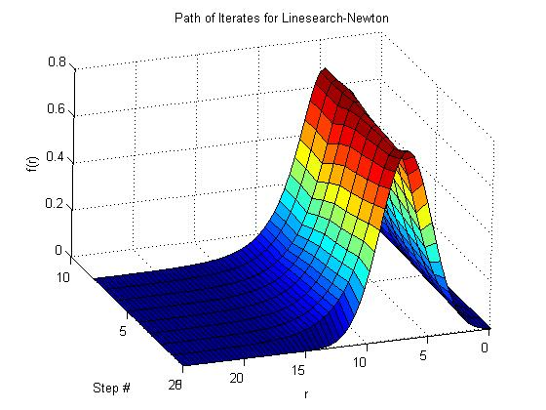
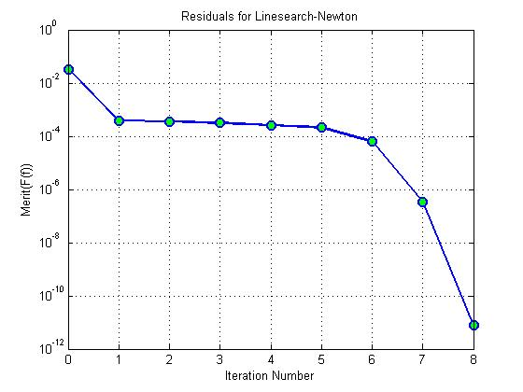
Newton’s Method RESULTS

Slide 26
Step# Residual Condition(J) LineS Step#
-----------------------------------------------
0 0.033363214 0 0
1 0.00039380249 421.00531 0
2 0.00035989367 2604.837 2
3 0.00031341553 2578.9335 2
4 0.00026149268 2505.3694 2
5 0.00020880265 2408.0862 1
6 6.245865e-005 2193.6241 0
7 3.3290085e-007 1714.4091 0
8 7.7006987e-012 1630.077 0
Total Steps: 8
-----Final Condition Properties---------
Max: 0.7773
CM: 6.7029
Mass: 2.1191

Slide 27
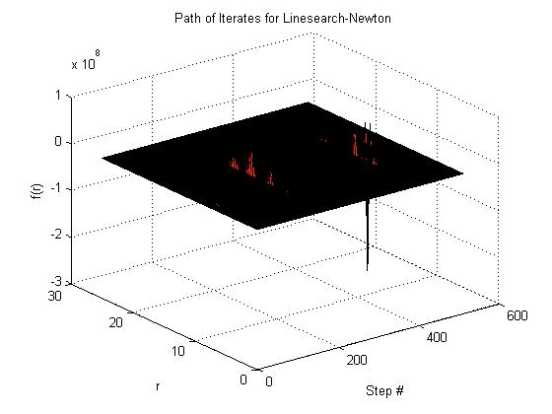
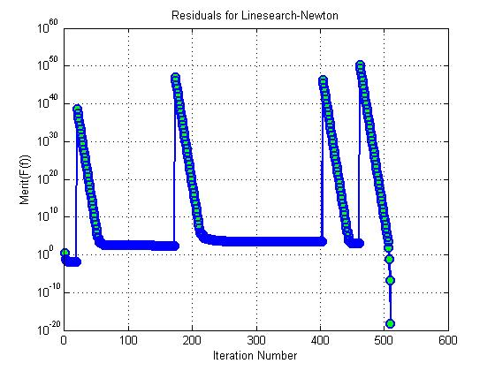
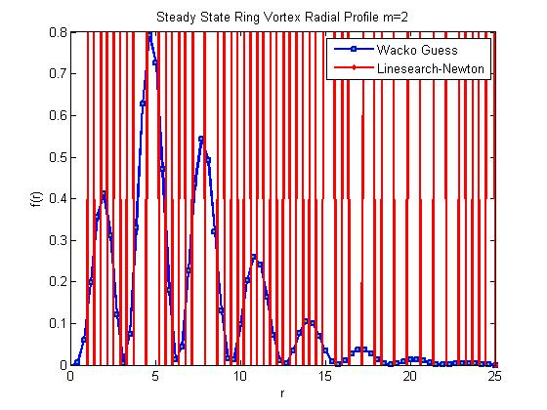
Newton’s Method RESULTS

Slide 28
Step# Residual Condition(J) LineS Step#
-----------------------------------------------
0 10.30707460404252 0 0
1 3.797131473139255 322.4617916529514 1
2 0.07115109498970441 943.6074879975586 0
3 0.03744462278914643 490.1899153456031 1
4 0.02365792022086447 611.4123317512531 1
5 0.01918080282968191 854.8242505100453 1
6 0.01651704407930783 1532.170036961514 2
7 0.01490582303286623 2107.968491008808 2
8 0.0141008652947429 3786.49236656563 3
9 0.01389364070957266 6042.567133434887 3
10 0.01388801557441571 64263.63095271237 8
11 0.01388699122837631 143064.9832301558 9
12 0.01388699121673601 46671125.13037878 21
13 0.01388699121530514 133858352.1706111 23
14 0.01388699121526349 486981616.0436305 25
15 0.01388699121525387 1629561163.706319 28
16 0.01388699121525355 5905195283.845445 30
17 0.01388699121525349 20594014523.17369 33
18 0.01388699121525349 93077636849.30943 35
19 0.01388699121525349 80755513787.10925 36
20 3.062685219395272e+038 199527754813.8188 37
21 2.688797510252713e+037 123479431.4044606 0
22 2.360551068312359e+036 123496946.7286027 0
23 2.072360590807894e+035 123535740.3969428 0
24 1.819359251158322e+034 123624004.0639431 0
25 1.597245474102144e+033 123823715.518533 0
26 1.402250926467128e+032 124274961.154876 0
27 1.231059933712162e+031 125302980.4081386 0
28 1.08076857954966e+030 127684124.6453414 0
29 9.488249542925848e+028 133414019.4673169 0
30 8.329864720128605e+027 148565725.9665471 0
31 7.312905089990378e+026 201106191.9085737 0
32 6.420113028024181e+025 1213598918.433669 0
33 5.636313625281138e+024 106312327.4968097 0
34 4.948202817671482e+023 412868538.8075058 0
35 4.344101844881039e+022 70391619.55867852 0
36 3.813752599680354e+021 69134151.76510152 0
37 3.348150120193049e+020 43623211.44328512 0
38 2.939390592610986e+019 21440336.2786524 0
39 2.580534133097374e+018 6155072.032409518 0
40 2.265488073079859e+017 3568437.662941985 0
477 2.826378723668735e+034 964788687917.1434 0
478 2.481333428351101e+033 428850710945.7627 0
479 2.178414714881758e+032 190617284739.9199 0
480 1.912461923662651e+031 84723322546.55176 0
481 1.678984860450694e+030 37656122408.94354 0
482 1.474010201362974e+029 16736465162.63288 0
483 1.294059494646432e+028 7438565641.04763 0
484 1.13607252232962e+027 3306068057.195754 0
485 9.973737387786114e+025 1469374478.564027 0
486 8.756099962055483e+024 653058589.8246759 0
487 7.687108296911345e+023 290249114.0527888 0
488 6.74862353352539e+022 128999869.6401254 0
489 5.924718054396952e+021 57333372.47835999 0
490 5.201397689937174e+020 25481530.51197834 0
491 4.566380994231568e+019 11325134.57751725 0
492 4.008886654001893e+018 5033397.478228724 0
493 3.51944739406462e+017 2237068.565268261 0
494 3.089747750112105e+016 994255.3291986552 0
495 2712480828671470 441893.753430446 0
496 238121866488545.8 196399.6737319039 0
497 20902916597710.03 87291.18348772884 0
498 1834668225024.781 38798.52500571331 0
499 160981651201.3958 17246.24725566289 0
500 14115018748.53688 7667.492347388859 0
501 1235395656.742199 3410.344505397613 0
502 107620312.0843097 1518.435722501113 0
503 9257296.041192498 677.8817909395556 0
504 768682.389541843 304.805679146856 0
505 57569.91218064942 139.8223287952065 0
506 3138.324498363206 67.91516699487674 0
507 63.43544352521602 38.67666622765344 0
508 0.07771395352118861 31.04672093946703 0
509 1.497480835831153e-007 31.04672094532632 0
510 5.61666712243844e-019 31.04672094385549 0
Total Steps: 510
-----Final Condition Properties---------
Max: 5.4701
CM: 11.8571
Mass: 523.059

Slide 29
Gauss-Newton
So far, it is clear that just adding a linesearch to Newton’s method is not enough.
Due to the degenerate solutions, the linesearch can get caught.
To fix this, the Newton step is redefined as:
For any lambda > 0, the matrix in parentheses is nonsingular, and if lambda-k
is bounded away from zero, then there is good convergence.
Using this step, the linesearch should never fail because degenerate solutions are avoided.
One problem is how to pick lambda. This can be done in a trust-region framework,
But for now, lambda is chosen as a constant through guess-and-check.
If lambda is too big, then convergence is slower and it makes the step steepest decent.
If it is too small, then near singularities, the algorithm will slow down considerably.
For the next run, lambda is set to:

Slide 30
Gauss-Newton
RESULTS

Slide 31
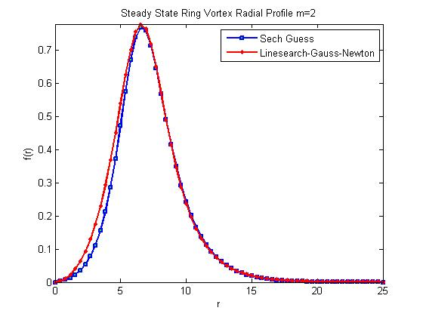
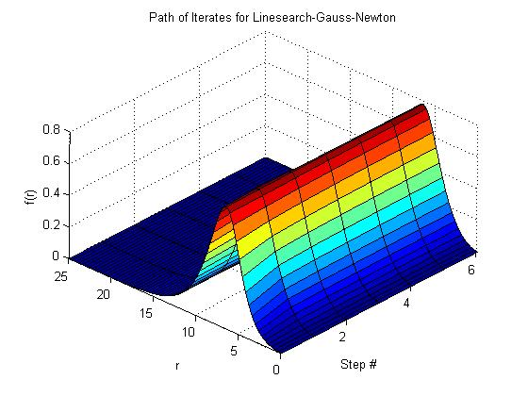
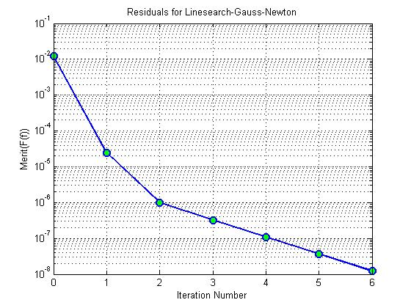
Newton’s Method RESULTS

Slide 32
Step# Residual Condition(J) LineS Step#
-----------------------------------------------
0 0.012172379 0 0
1 2.4978868e-005 581.54652 0
2 1.0018986e-006 1676.447 0
3 3.252163e-007 1675.3097 0
4 1.0887742e-007 1649.4483 0
5 3.6647626e-008 1634.7278 0
6 1.2334889e-008 1626.5048 0
Total Steps: 6
-----Final Condition Properties---------
Max: 0.77686
CM: 6.7104
Mass: 2.1185

Slide 33
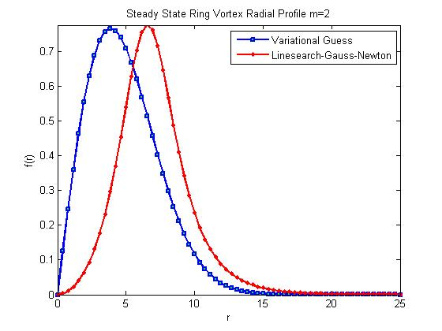
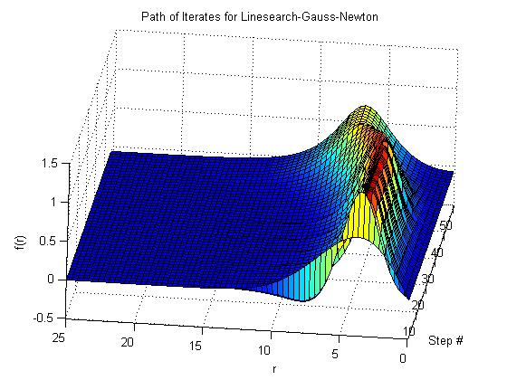
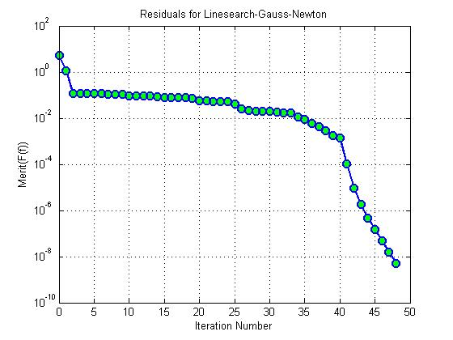
Newton’s Method RESULTS

Slide 34
Step# Residual Condition(J) LineS Step#
-----------------------------------------------
0 5.2261979 0 0
1 1.17443074 796.15015 0
2 0.121301886 182.089013 0
3 0.120740426 732.079069 2
4 0.118291961 922.496633 4
5 0.116265522 1324.31392 4
6 0.11567265 2470.41232 3
7 0.112292716 2570.26623 3
8 0.110370678 2028.88123 4
9 0.105349429 4979.16925 3
10 0.0954534982 6076.20473 2
11 0.0935253775 889.951838 4
12 0.0918839362 1163.484 4
13 0.0903646749 1726.04564 4
14 0.0882267024 3182.72019 3
15 0.0812896552 5539.7502 2
16 0.0797084879 980.361731 4
17 0.0783155952 1273.7469 4
18 0.0769663643 1835.35475 4
19 0.0750561337 3062.46145 3
20 0.0577633976 10410.073 1
21 0.0554059966 556.826579 3
22 0.0539590595 714.149362 3
23 0.053491682 1040.21045 3
24 0.0525756126 2047.06199 3
25 0.0424622446 8892.10437 1
26 0.0252076804 13554.6037 0
27 0.0221231594 374.014647 2
28 0.0205175847 465.854743 2
29 0.0203108517 627.068742 2
30 0.0193096702 980.821054 3
31 0.0183843021 1205.61064 3
32 0.0174773285 1530.71206 3
33 0.016978035 1989.67954 2
34 0.0116549958 6047.73713 1
35 0.00859764016 4538.70281 1
36 0.0060447458 3948.3488 1
37 0.00424140157 3129.59974 1
38 0.00278964133 2709.6072 1
39 0.00173682549 2354.90845 1
40 0.00141490548 2092.31577 0
41 0.000107834744 1877.19416 0
42 9.5562763e-006 1619.53386 0
43 1.78801352e-006 1543.70788 0
44 4.77682172e-007 1564.40485 0
45 1.46988778e-007 1583.35739 0
46 4.75487917e-008 1596.1613 0
47 1.56736485e-008 1604.11259 0
48 5.20733862e-009 1608.88169 0
Total Steps: 48
-----Final Condition Properties---------
Max: 0.77757
CM: 6.6981
Mass: 2.1195

Slide 35
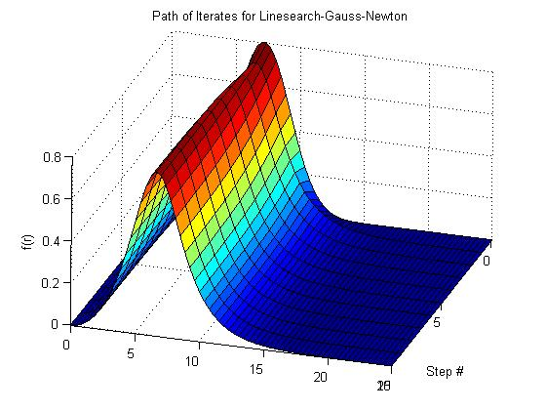
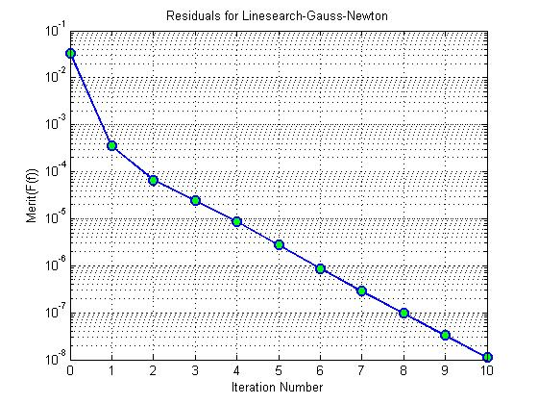
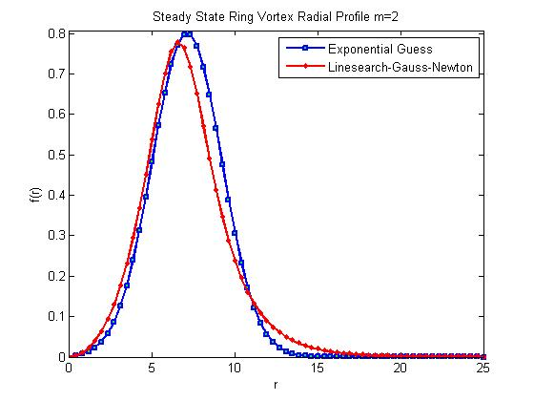
Newton’s Method RESULTS

Slide 36
Step# Residual Condition(J) LineS Step#
-----------------------------------------------
0 0.033363214 0 0
1 0.0003528951 421.00531 0
2 6.6097794e-005 2640.6013 0
3 2.4057369e-005 2267.1646 0
4 8.6404953e-006 1956.2457 0
5 2.7426529e-006 1805.8105 0
6 8.7826157e-007 1719.4117 0
7 2.8958286e-007 1672.7126 0
8 9.7045298e-008 1647.477 0
9 3.2670046e-008 1633.6193 0
10 1.0994715e-008 1625.8813 0
Total Steps: 10
-----Final Condition Properties---------
Max: 0.77688
CM: 6.71
Mass: 2.1185

Slide 37
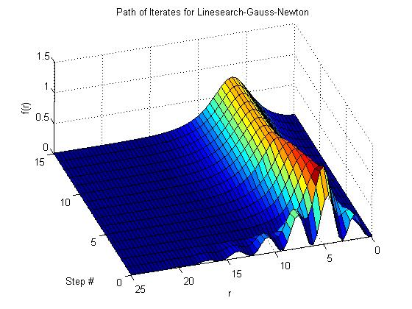
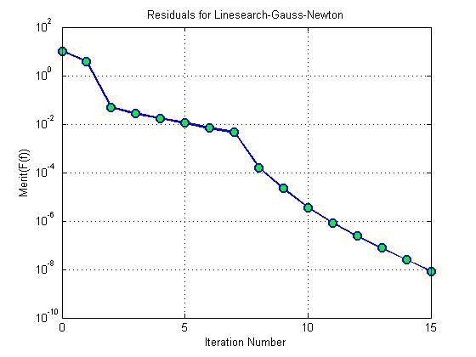
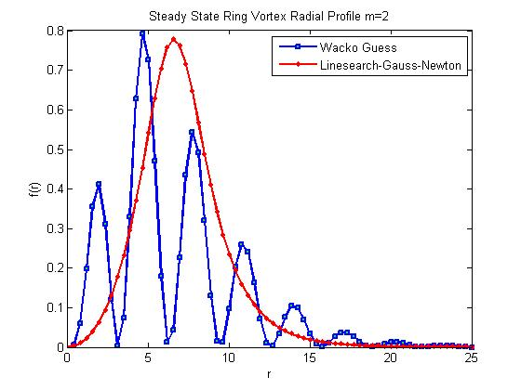
Newton’s Method RESULTS

Slide 38
Step# Residual Condition(J) LineS Step#
-----------------------------------------------
0 10.307075 0 0
1 3.8129992 322.46179 1
2 0.048936352 1003.7395 0
3 0.027010054 559.20739 1
4 0.017041105 727.18431 1
5 0.011276962 1015.822 1
6 0.0068540279 1469.0448 1
7 0.0045827459 1908.6284 0
8 0.00016067655 3076.1892 0
9 2.2035578e-005 1711.9017 0
10 3.483065e-006 1530.5345 0
11 8.2171267e-007 1555.2998 0
12 2.4201125e-007 1575.9489 0
13 7.7076493e-008 1591.3427 0
14 2.5253069e-008 1601.1653 0
15 8.3679269e-009 1607.1263 0
Total Steps: 15
-----Final Condition Properties---------
Max: 0.77765
CM: 6.6968
Mass: 2.1196

Slide 39
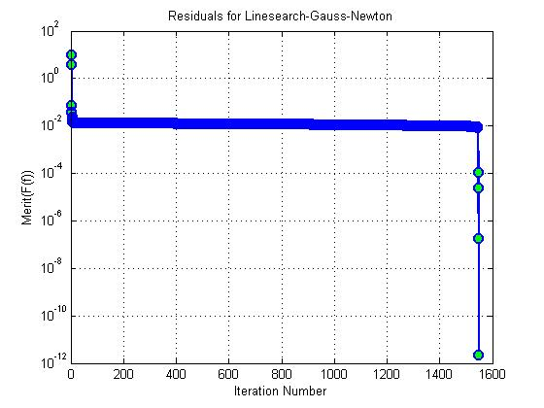
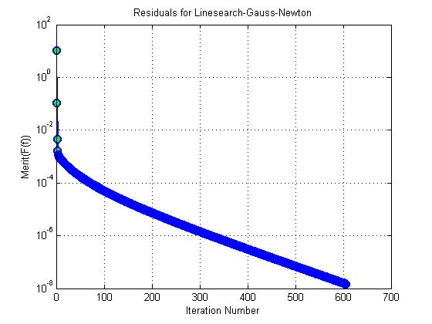
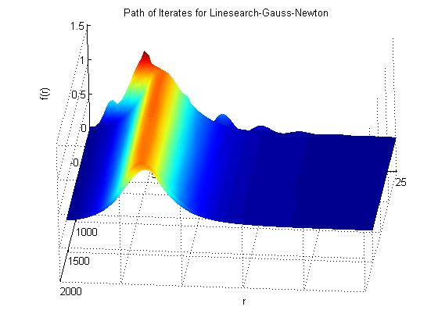
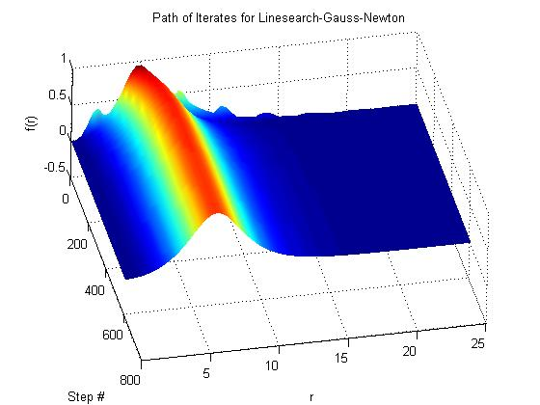
Different Choices for Lambda on Initial Condition #4
Total Steps: 1548
Total Steps: 606

Slide 40
Quasi-Newton (Broyden)
Another method to try is a Quasi-Newton method, which uses an approximation for J instead of J itself when using the classic Newton step.
This approximation is updated at each iteration as follows:
Where:
(Alpha is determined by the merit function linesearch as before)

Slide 41
Quasi-Newton (Broyden)
RESULTS

Slide 42
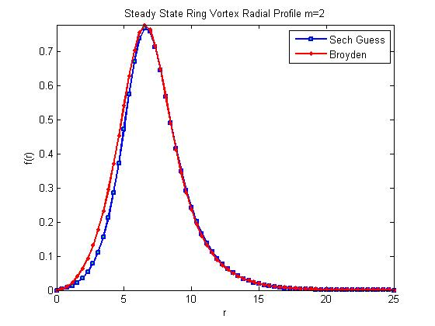
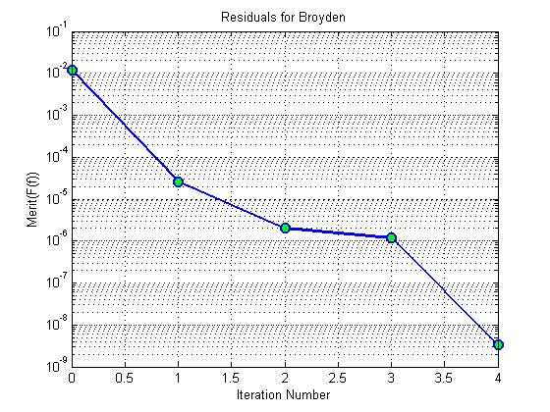
Newton’s Method RESULTS

Slide 43
Step# Residual Condition(J) LineS Step#
-----------------------------------------------
0 0.012172379 0 0
1 2.6278264e-005 953.40311 0
2 2.0088825e-006 1006.5361 0
3 1.1701014e-006 2559.1281 0
4 3.2786069e-009 2793.3739 0
Total Steps: 4
-----Final Condition Properties---------
Max: 0.77739
CM: 6.7018
Mass: 2.1192

Slide 44
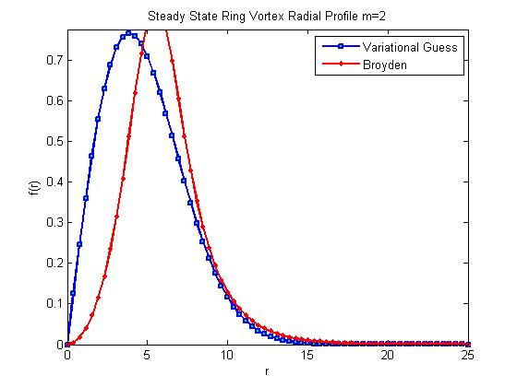
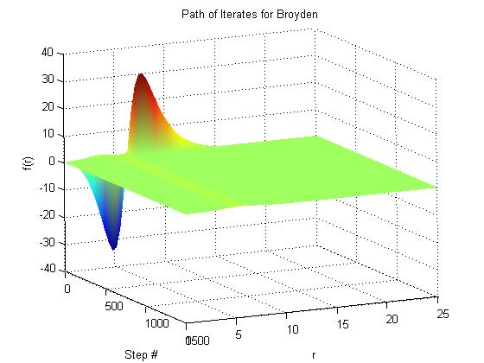
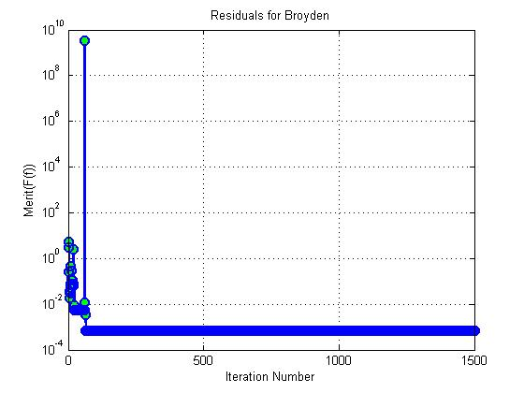
Newton’s Method RESULTS

Slide 45
Step# Residual Condition(J) LineS Step#
-----------------------------------------------
0 5.2261979025002 0 0
1 2.9917249954597 1314.8879225897 0
2 0.25065188637775 603.92919368304 0
3 0.27099832319429 428.533167421 37
4 0.032572834588578 306.49084910522 0
5 0.019068680881299 372.66028149121 1
6 0.034578303358565 1597.6375964043 37
7 0.029886591592975 807.23320501871 1
8 0.074668228334417 2570.9267917182 37
9 0.054917408012885 1794.8578391351 2
10 0.46013560089927 5029.1451959947 37
11 0.27649976478882 400.13985916723 0
12 0.27649976478882 665.45392007193 36
13 0.11946363842403 826.53472522619 1
14 0.11570635451863 625.38669381925 2
15 0.10973902024193 4397.5575226391 3
16 0.078420427076399 753.61545095197 1
17 0.076866331702958 2958.6666035248 3
18 0.076304863283344 4087.2315126555 4
19 0.065754178392485 2092.5409994064 2
20 2.5321232805362 26435.310605558 37
21 0.0088223430213582 214.56738437687 0
22 0.0086516186413481 214.53226945634 0
23 0.0057299192433742 687.65863896495 1
24 0.0057299192433742 1069.3527978587 34
25 0.0057187317857049 1917.1605815569 5
26 0.0057174065696903 11800.058071599 7
27 0.0056671104911006 4542.4567956791 5
28 0.0056365934336629 3489.4434997296 5
29 0.0056074953709843 4031.6126156655 5
30 0.0055878352242799 4413.3297735082 5
31 0.005585972682772 5255.9111499863 5
32 0.0055840276071676 6989.1333534931 7
33 0.0055671269574413 5917.3651102799 5
34 0.0055670119477652 6591.4220684655 6
35 0.0055658923882806 9505.4758133001 6
36 0.0055632800637223 8974.3062533826 7
37 0.0055532193328798 8485.7464530267 6
38 0.0055519178969987 8926.8958986406 6
39 0.0055517630295222 16817.506514348 9
40 0.005546496326862 13650.222983956 7
41 0.005542645329403 11171.633068302 7
42 0.0055409348268817 15392.641347049 7
43 0.0055407686053255 24554.926201169 9
44 0.0055394547693904 25671.7285406 8
45 0.0055389329507734 23074.717716688 8
46 0.0055387996753462 39454.612247999 10
47 0.0055380523527224 34625.981155741 9
48 0.0055374581809894 30989.799436512 9
49 0.0055372104583206 42834.200341991 9
50 0.0055372022819186 80544.503167369 12
51 0.0055370538057079 81738.438334998 10
52 0.0055370295473454 79962.232645841 11
53 0.0055370134888389 132650.54298817 11
54 0.005537010187767 147565.0805126 12
55 0.0055369983089987 198030.86125352 12
56 0.0055369903384831 198080.00387307 13
57 0.0055369790171057 220259.26564592 12
58 0.0055369790166008 378535.12376567 18
59 0.0055369733085996 528582.70848904 14
60 0.0055369706010076 329641.72168416 13
61 3389424620.5822 1191433.4771094 37
62 0.011520214445204 4840.3903683731 0
63 0.003298111043992 4840.3691301579 0
64 0.00066469182889549 4065.3485926024 0
65 0.00066388914769088 4059.3949594562 1
66 0.00066354328638197 4016.6533419732 1
67 0.0006634053933799 3945.628753333 1
68 0.00066331870119795 3835.5782055978 1
69 0.00066326071588624 4119.0081060794 1
70 0.00066326071588623 4585.3866108885 24
71 0.00066326071588622 5174.2917547401 24
72 0.00066326071588622 5584.8004752307 26
73 0.00066326071588622 5806.0052553217 30
74 0.00066326071588622 5806.0052553217 30
75 0.00066326071588622 5806.0052553217 30
76 0.00066326071588622 5806.0052553217 30
77 0.00066326071588622 5806.0052553217 30
1500 0.00066326071588622 5806.0052553217 30
Total Steps: 1500 MAXED OUT
-----Final Condition Properties---------
Max: 0.8322
CM: 5.6863
Mass: 2.2366

Slide 46
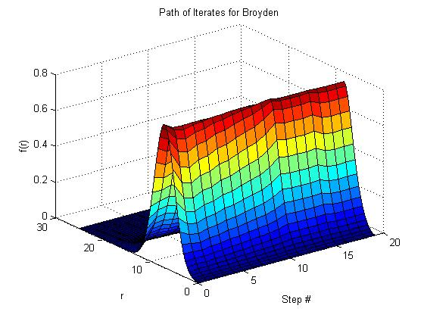
Newton’s Method RESULTS

Slide 47
Step# Residual Condition(J) LineS Step#
-----------------------------------------------
0 0.033363214 0 0
1 0.00039380249 729.57515 0
2 0.00034299717 950.40036 1
3 0.00028570234 3808.4368 2
4 0.00028532539 3683.878 3
5 0.00028427257 4135.7908 2
6 0.00028170711 4256.4326 3
7 0.00026528062 4266.2581 2
8 0.00025843644 4113.8641 2
9 0.00023478627 4013.0055 2
10 0.0001979537 3591.2366 1
11 0.00014779079 3169.2158 0
12 1.5785699e-005 2391.7609 0
13 1.5785699e-005 3300.1732 32
14 1.251388e-005 1936.2365 2
15 1.1813759e-005 5205.8996 2
16 3.7081122e-006 2215.4066 0
17 1.7429876e-006 2800.5565 0
18 5.3598071e-008 1848.2946 0
19 5.0386597e-009 1490.4412 0
Total Steps: 19
-----Final Condition Properties---------
Max: 0.7775
CM: 6.6994
Mass: 2.1194

Slide 48
Newton’s Method RESULTS

Slide 49
Step# Residual Condition(J) LineS Step#
-----------------------------------------------
0 10.3070746 0 0
1 3.797131473 558.882824 1
2 0.2506005568 576.9026697 0
3 0.08620565163 226.760973 0
4 0.02260403286 221.0476911 0
5 0.004176515449 218.1570875 0
6 0.003444866834 313.5912467 1
7 0.004378873231 2402.013936 37
8 0.003473258927 2237.771443 2
9 0.00342702341 3318.86543 3
10 0.006264071563 5559.220733 37
11 0.004531397701 1865.175918 2
12 0.004531397701 1773.678277 33
13 0.004495502951 18180.47394 6
14 0.004444235427 8184.162539 5
15 0.004419580972 11806.22131 5
16 0.004412871683 238827.2859 9
17 254.7833018 78224.81579 37
18 0.03433390259 278.3318279 0
19 0.003924099809 281.0226692 0
20 0.003913767991 219.3936908 2
21 0.003913767991 220.7721571 32
22 0.003913767991 323.4491447 35
23 0.003913767991 347.7918538 35
24 0.003913767991 331.7180625 34
25 0.003861234013 10481.99403 6
26 0.003861234013 4506.271889 35
27 0.003599755014 2579.311796 2
28 0.003587282778 1919.790514 3
29 0.003587282778 2486.555962 34
30 0.003375352305 10689.0822 4
31 0.003375352305 32411.88083 36
32 15.92465937 66228.54217 37
33 0.04818267851 769.417108 0
34 0.1485655685 1224.299858 37
35 0.004091540931 215.5062942 0
36 0.002334323455 217.0735641 0
37 0.002334323455 875.9960304 34
38 0.002334323455 6164.92147 35
39 0.002334323455 1133.838149 36
40 0.002323082417 576.5257489 4
41 0.002323082417 3695.839568 35
42 0.003585763107 2395.45642 37
43 0.002644140955 2049.548634 2
44 0.002457870081 2664.826624 3
45 0.002457436752 5154.72358 6
46 0.002457436752 4712.238313 34
47 0.002457436752 8947.460422 34
48 23.61242428 53709.50286 37
49 2.987563127 2534.61813 0
50 0.02095633478 307.8271645 1
51 0.01068229785 213.9874015 0
52 0.01966868591 1859.934894 37
53 0.009400501095 608.044348 0
54 0.002940279343 807.861584 0
55 0.002940279343 1101.631662 36
56 0.002940279343 1101.631662 36
57 0.002940279343 1101.631662 36
………………………………………………………….
1500 0.002940279343 1101.631662 36
Total Steps: 1500 MAXED OUT
-----Final Condition Properties---------
Max: 0.82599
CM: 5.5361
Mass: 2.2082

Slide 50
Initial Condition 1: Sech Guess:
---------------------------------------------------------
Method Steps
---------------------------------------------------------
Smarquardt.m 24
Classic Newton 3
Linesearch-Newton 3
Linesearch-Gauss-Newton 6
Broyden 4
Initial Condition 2: VA Guess:
---------------------------------------------------------
Method Steps
---------------------------------------------------------
Smarquardt.m 84
Classic Newton 61
Linesearch-Newton 581
Linesearch-Gauss-Newton 48
Broyden 1500
Final Comparison
RESULTS
Initial Condition 3: Exp Guess:
---------------------------------------------------------
Method Steps
---------------------------------------------------------
Smarquardt.m 33
Classic Newton 6
Linesearch-Newton 8
Linesearch-Gauss-Newton 10
Broyden 19
Initial Condition 4: Wacko Guess:
---------------------------------------------------------
Method Steps
---------------------------------------------------------
Smarquardt.m 46
Classic Newton 48
Linesearch-Newton 510
Linesearch-Gauss-Newton L10^-4 15
Linesearch-Gauss-Newton L10^-8 1548
Linesearch-Gauss-Newton L10^-1 606
Broyden 1500

Slide 51
Codes Written
For this project, the following codes were written, altered, or were previously written for MS research:
M693AProject.m Main program (selects method and runs them)
NLS_STEADY_F.m Finite Difference for the ODE w/ Dirichlet BCs
rmc_fdjac.m Finite Diff Approx for Jacobian (FD and CD)
rmc_Nlnewton.m Newton and Gauss-Newton w/ and w/o LS
rmc_linesearch.m Linesearch using backtracking
rmc_NLSmeritF.m Merit function for NLS_STEADY_F
rmc_NLBroyden.m Broyden Method using Line Search
-------------------------------------------------------------------------------------------------
Smarquardt_rmc.m Slightly changed version of H. B. Nielsen’s code using rmc_fdjac.m with CD

Slide 52
Conclusion
It seems that the Classic Newton’s method is actually the best to use if the initial condition is close to the solution.
However, if the initial condition is far from the solution, then it seems that the Gauss-Newton method is the way to go, but in practice, one would use a smarter way of choosing lambda, and update it each step (and use a trust-region approach instead of a linesearch).

