Slide 1



Study of Vortex Ring Dynamics in the
Nonlinear Schrödinger Equation utilizing GPU-Accelerated High-Order Compact
Numerical Integrators
Ph.D. Dissertation Proposal
Ronald M. Caplan
March 25th 2011

Slide 2
Outline
Physical Motivation
Mathematical Models
Numerical Algorithms
Code Implementation
Computer Simulations and Analysis

Slide 3
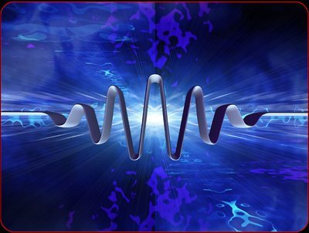
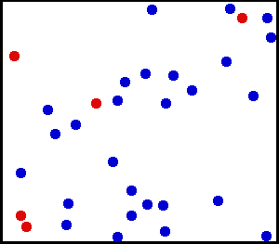
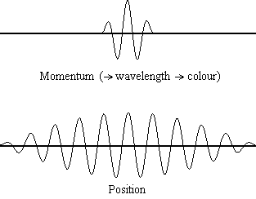
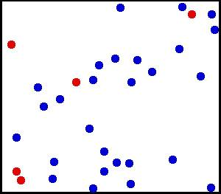
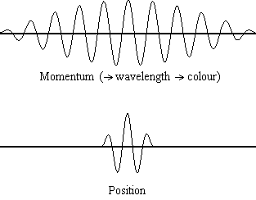
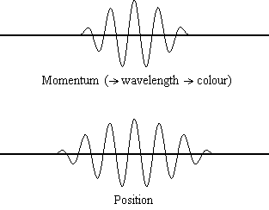
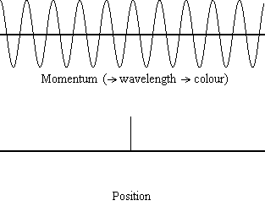
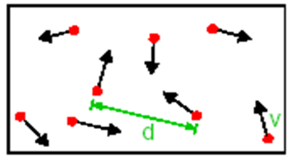
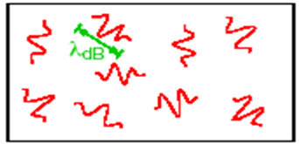
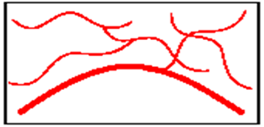
Physical Motivation
Bose-Einstein Condensates
Heisenberg Uncertainty Principle
Dilute Gas
de Broglie wavelength
BEC
“High” Temperature
Low Temperature
Critical Temperature

Slide 4
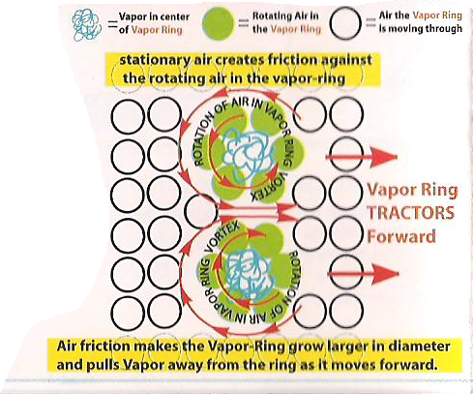
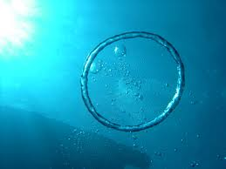
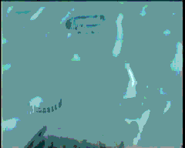
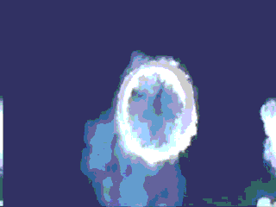
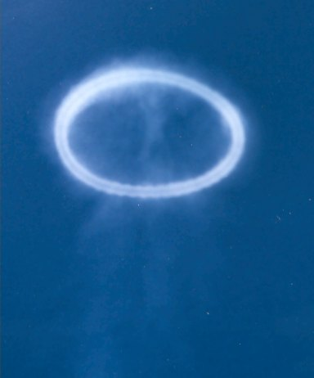
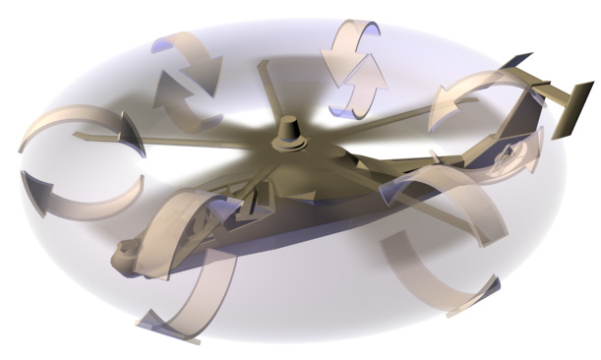
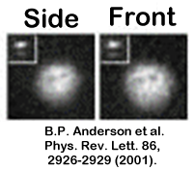
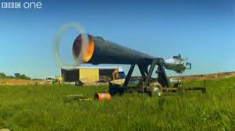
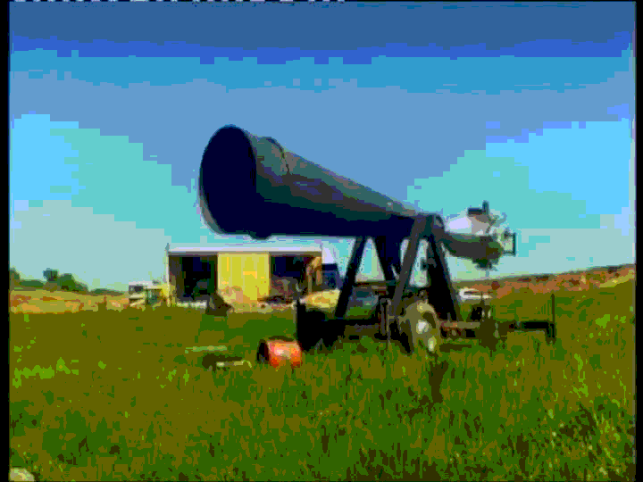
Physical Motivation
Vortex Rings

Slide 5

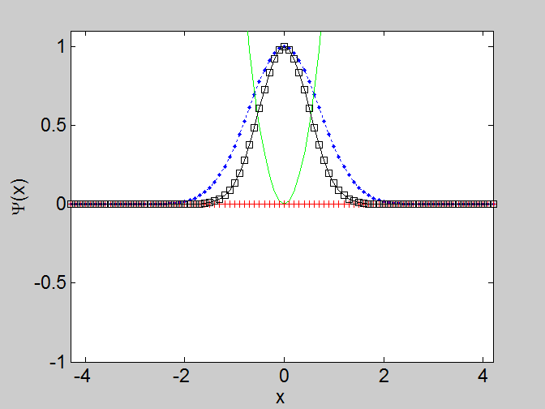
Mathematical Models
Nonlinear Schrödinger Equation
Laplacian
Parameter
Wavefunction – Real and Imaginary Parts
External Potential
Parameter
Observable
Frequency

Slide 6
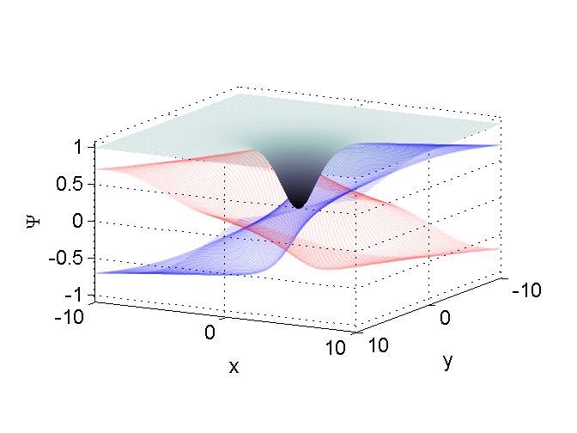
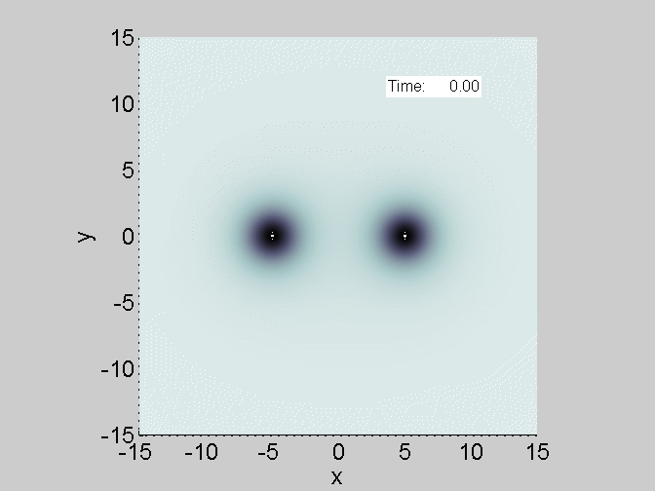
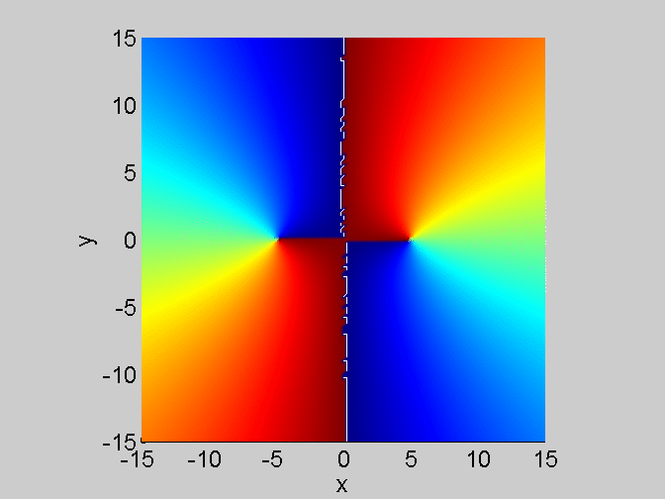
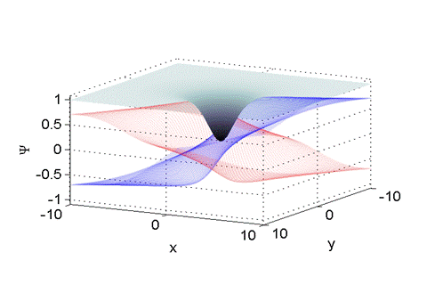
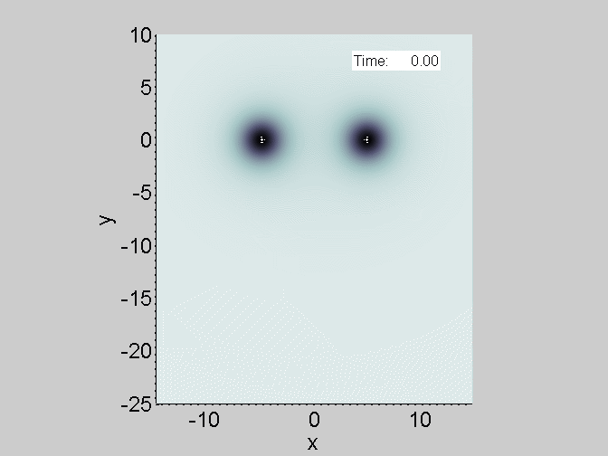
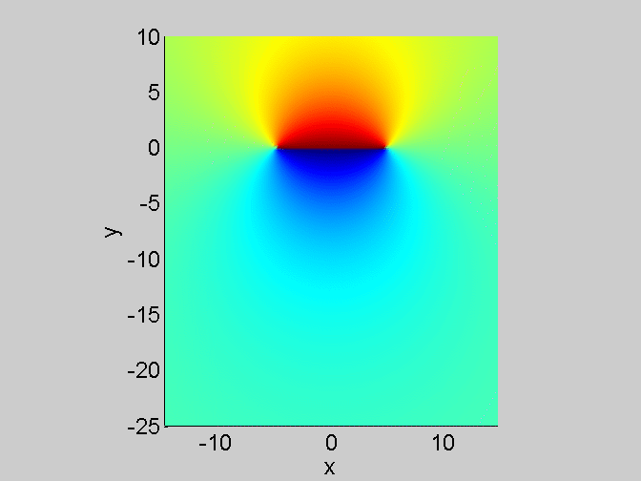
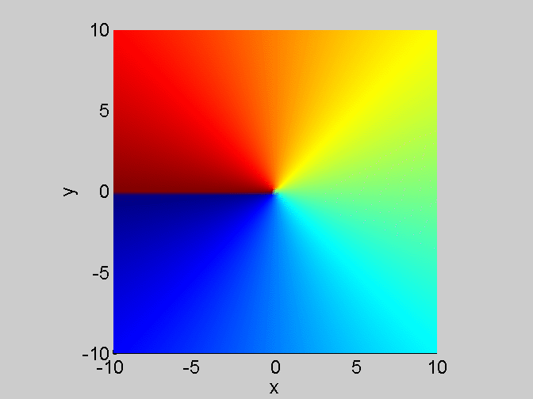
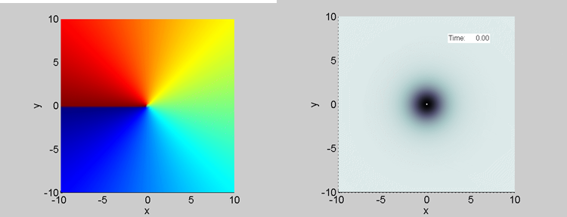
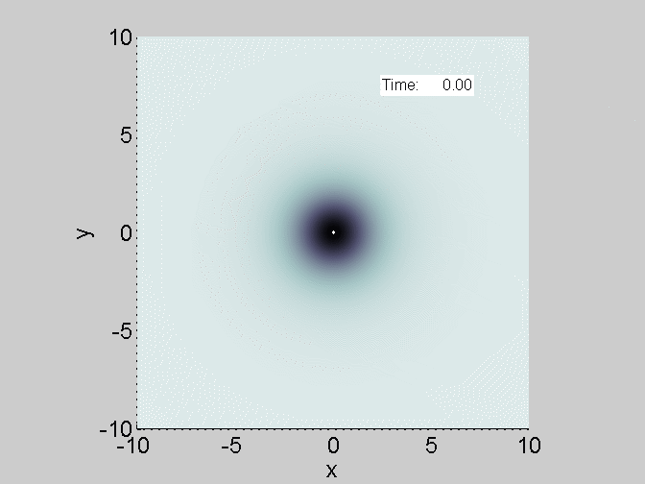
Mathematical Models
2D Vortex Review
Structure
Interaction Dynamics
Equal unitary charge
Opposite unitary charge

Slide 7
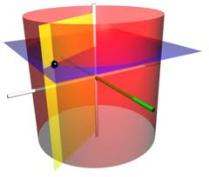
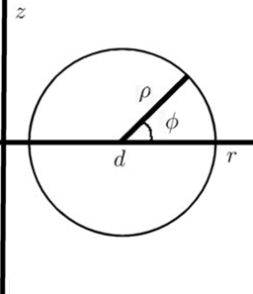
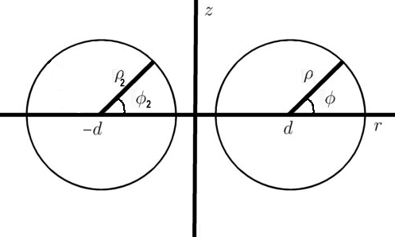
Mathematical Models
Vortex Rings
Cylindrical Coordinates
Cylindrical Axisymmetric Coordinates
Vortex Ring Velocity [P.H. Roberts et. al (1971)]
Vortex Ring Structure
Further work
Formulate steady-state PDE for new IC.
Asymptotic analysis.

Slide 8
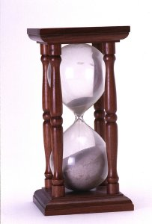

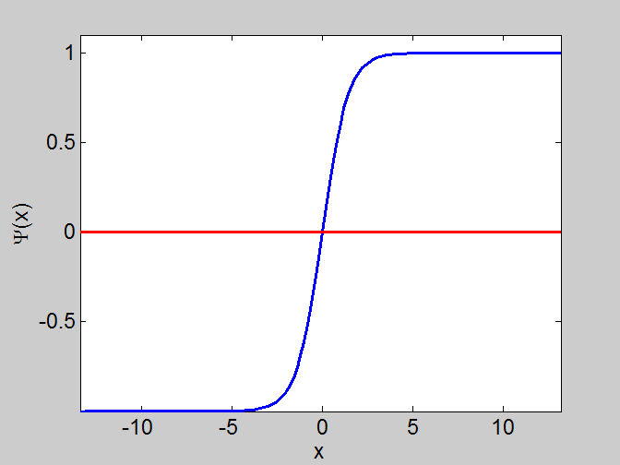
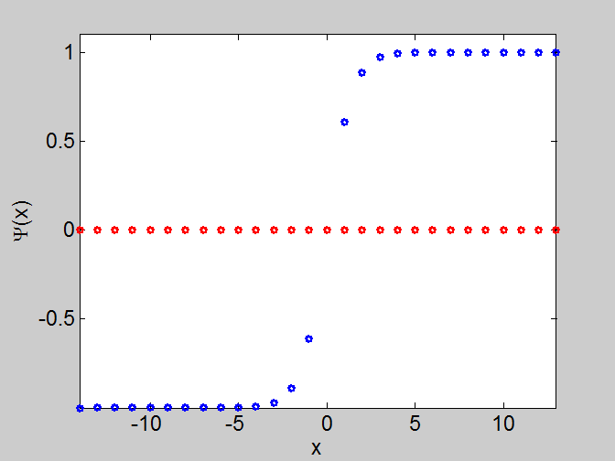
Numerical Algorithms
Finite Difference and Runge-Kutta
Discretize Space
Method
of lines
Discretize Time
Simple time stepping (Euler)
Runga-Kutta (4-stage scheme)
Stability criteria

Slide 9
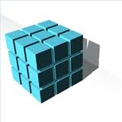

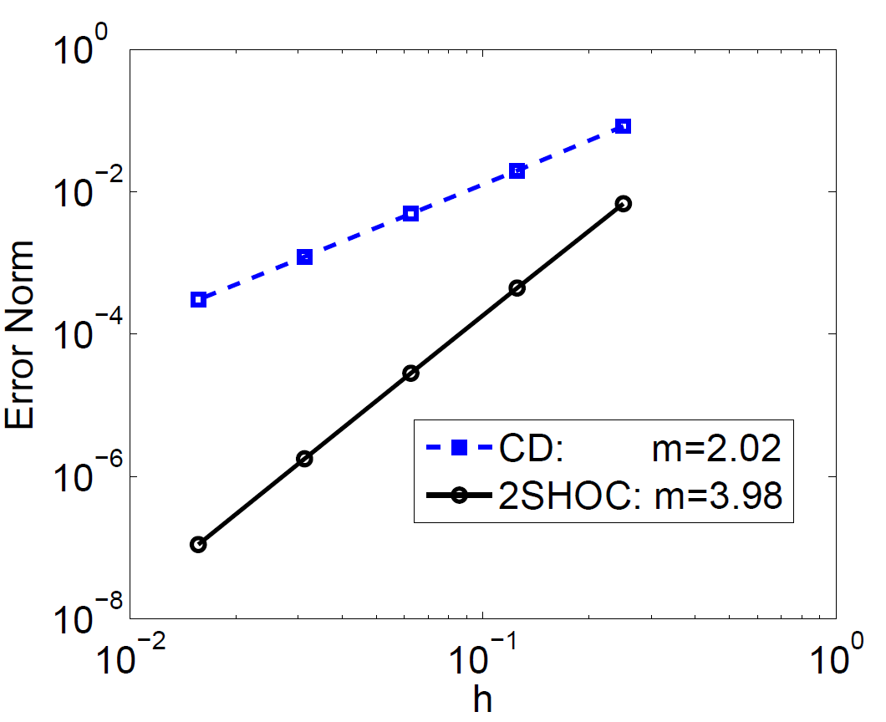
Numerical Algorithms
Two-Step High-Order Compact Scheme
Scheme formulated for
One-, two- and three-dimensional
Laplacian operators.
Further work
Complete stability analysis.
Additional numerical tests.
Publish results.

Slide 10
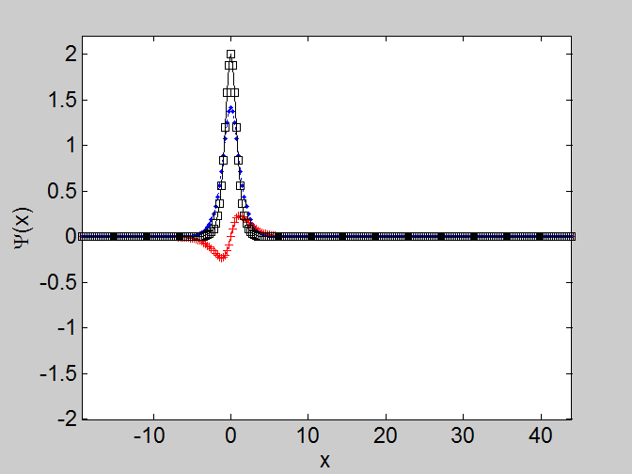
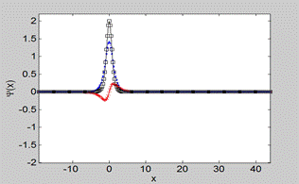
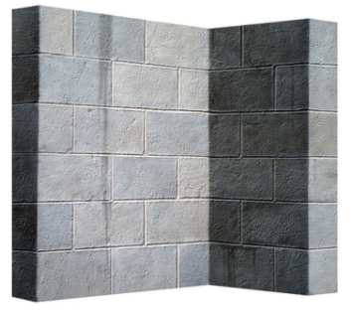
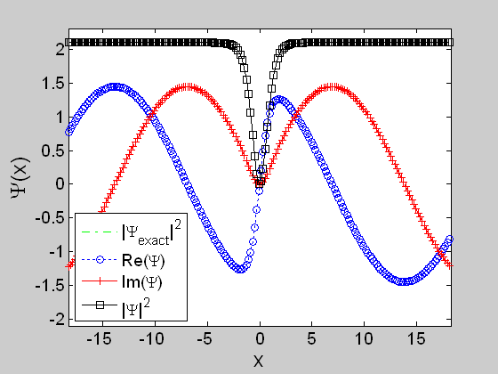
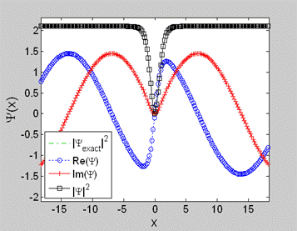
Numerical Algorithms
MSD Boundary Conditions
Want easy yet useful BCs
Dirichlet
Works great if “action”
Is far from the boundary.
For defocusing NLSE with no external potential, Dirichlet fails due to phase rotation.
Would like equivalent Dirichlet
but for the modulus-squared:
Modulus-Squared Dirichlet (MSD) boundary condition:
Already
computed!
Works for any time-dependent complex PDE and in any dimension
Further work
Numerical tests comparing accuracy, stability, and conservation to other BCs

Slide 11


Code Implementation
MATLAB and MEX
MathWorks® MATLAB
Used widely as educational tool and for research and industry
Offers easy integrated visualizations, analysis tools. built-in math
functions, easy to code, etc.
Why not use it for everything?
Since codes are scripts (not compiled), “real” code use is SLOW
Solution
Can write MEX files: C code with MATLAB interface.
Easy to port if needed
Allows compiled C code speed with the advantages of MATLAB
MEX
m_code.m
c_code.c
for # of chunks…
plot, etc…
end
for # of steps/chunk…
end
Further work
Script driver codes updated as new analysis, ICs, and graphics are required.

Slide 12
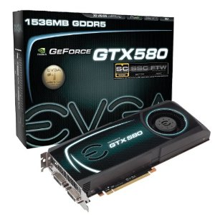
Code Implementation
GPUs and CUDA
Graphical Processing Units (GPUs)
Cheap: ~$1 per core for desktop card,
~$5 per core for compute-only workstation card.
Fast: Up to 1024 cores at ~1.5GHz per card,
Top card boasts peak ~2.0 Tflops fpp, 1 Tflops dp
Medium-large problem capacity: RAM 1.5GB -> 6.0GB
Why doesn’t everyone use it?
Not for all problems
Learning Curve: Need special C/FORTRAN code using CUDA API
Preexisting Conditions: Translation of standard parallel code into GPU “difficult”.
Portability: Vender-specific API. Solution: OpenCL
Why use it for this project?
Proving Ground: New code allows test to see if GPU computing is worthwhile.
MATLAB Compatible: Nvmex allows CUDA C code to be used in MEX file.
CUDA implementations of all NLSE 1D/2D/3D MEX codes completed!
Further work
Additional optimizations.
Timings with comparisons to high and low-end CPUs.
Compare GPU codes to other parallel implementations (speed and cost).

Slide 13
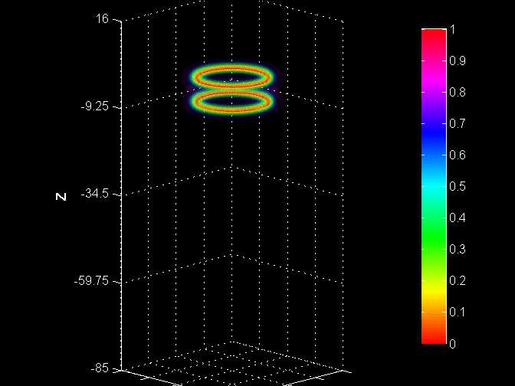
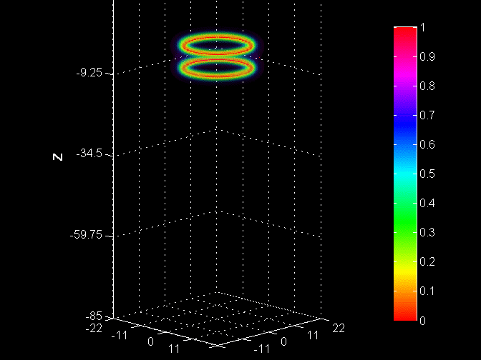
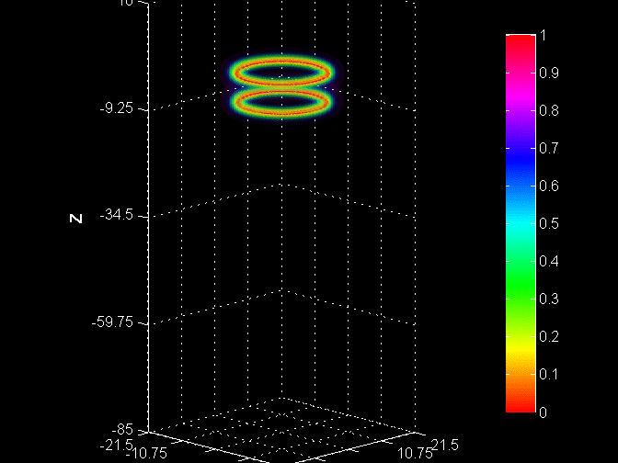



Code Implementation
Timing Result
MATLAB Script
MATLAB MEX
MATLAB CUDA-MEX
Simulation Details
Method: RK4 + 2SHOC
End time: 100.8
Time steps: 3360
k = 0.03 h = 0.5
Grid: 87x87x203 = 1,536,507
60 frames with 56 steps each
Plotting/movie time ~22.4 sec
System Details
Corei3 3.07 GHz Dual-thread
4GB RAM 64-bit Windows 7
MATLAB R2010b Cost~$650
GPU Details
NVIDIA GTX 580 Cost ~$500
Compute time
Compute time
Speedup
13.95X faster than MEX
Compute time
Speedup
5.58X faster than script
Speedup
77.8X faster than script

Slide 14


Code Implementation
Code Distribution: NLSEmagic
Distribution of codes – why?
Reproducibility of Computational Research
Contribution to further studies involving the NLSE
Return on Investment (CSRC, NSF)
http://www.nlsemagic.com
Further work
Finish 2D and 3D distributables.
Complete full-research codes for figure list.
Finish set-up documentation, write user documentation.

Slide 15
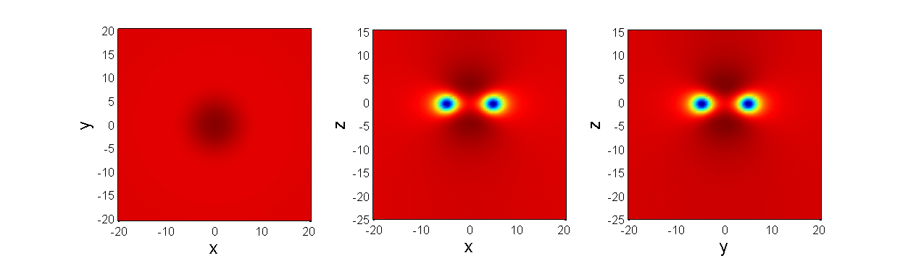
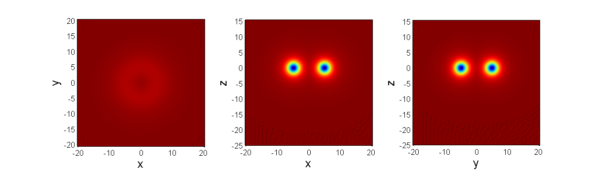
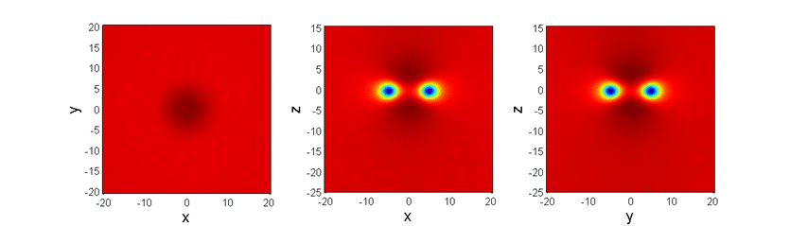
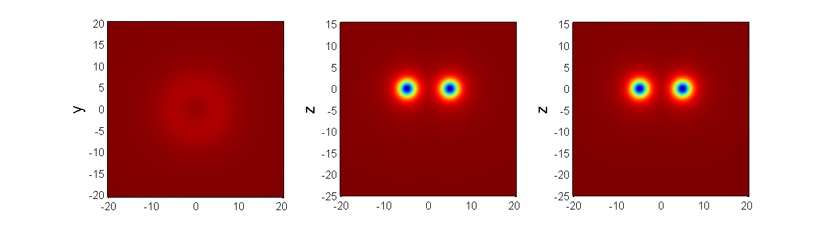



Computer Simulations and Analysis
Single Vortex Ring Structure and Dynamics
Original IC
Improved IC
Numerically “Exact” IC
Velocity vs radius
Quadrupole Oscillations
Further work
Improve optimizations.
Compare analytic and numerical velocities.
Additional initial conditions (rotated rings, deformations)
Improved tracking code using least-squares approach with low-parameter ansatz

Slide 16






Computer Simulations and Analysis
Multiple Vortex Ring Interactions
Vortex Ring Collisions
Vortex Ring Mergers
Further work
Multiple simulations of various scenarios.
Comparative analysis to 2D vortices for many cases.
Phenomenological model equations formulated from results.

Slide 17
Proposal Synopsis
Review of vortices in NLSE
Analytic NLSE VR description
Numerical Methods: 2SHOC,MSD
GPU Codes with MATLAB
NLSEmagic distributable software
Thorough numerical study of VR dynamics and interactions

Slide 18

Questions?

Slide 19
Numerical Algorithms
2SHOC: Some Details
Second order
differencing:
Define:
Take second
derivative
of differencing
Fourth order
approximation:
2SHOC (1D)
Fourth order Runga Kutta (RK4):
1)
2)

Slide 20
Numerical Algorithms
MSD BC: Some Details
Constant density at boundary:
Separate real and
imaginary parts:
Solution to ODEs,
but need C:
Rewrite Solution
Take spatial derivative
Discretize
Use above to get C:
MSD:
Applying to NLSE:

Slide 21
Code Implementation
GPU Codes: Some Details
CPU
GPU
Global memory
Input
Kernel call:
Shared
memory
…
Compute
Block 0
Block 1
Global memory
Output
CPU

